Slide 1
AVCDL Awareness
Charles Wilson
Staff Product Cybersecurity Architect
version 8
2024-04-11
Notes:
Script:
I'm Charles Wilson, Staff Product Cybersecurity Architect at Torc Robotics.
This presentation is an introduction of the AVCDL for non-cybersecurity individuals.

Slide 2
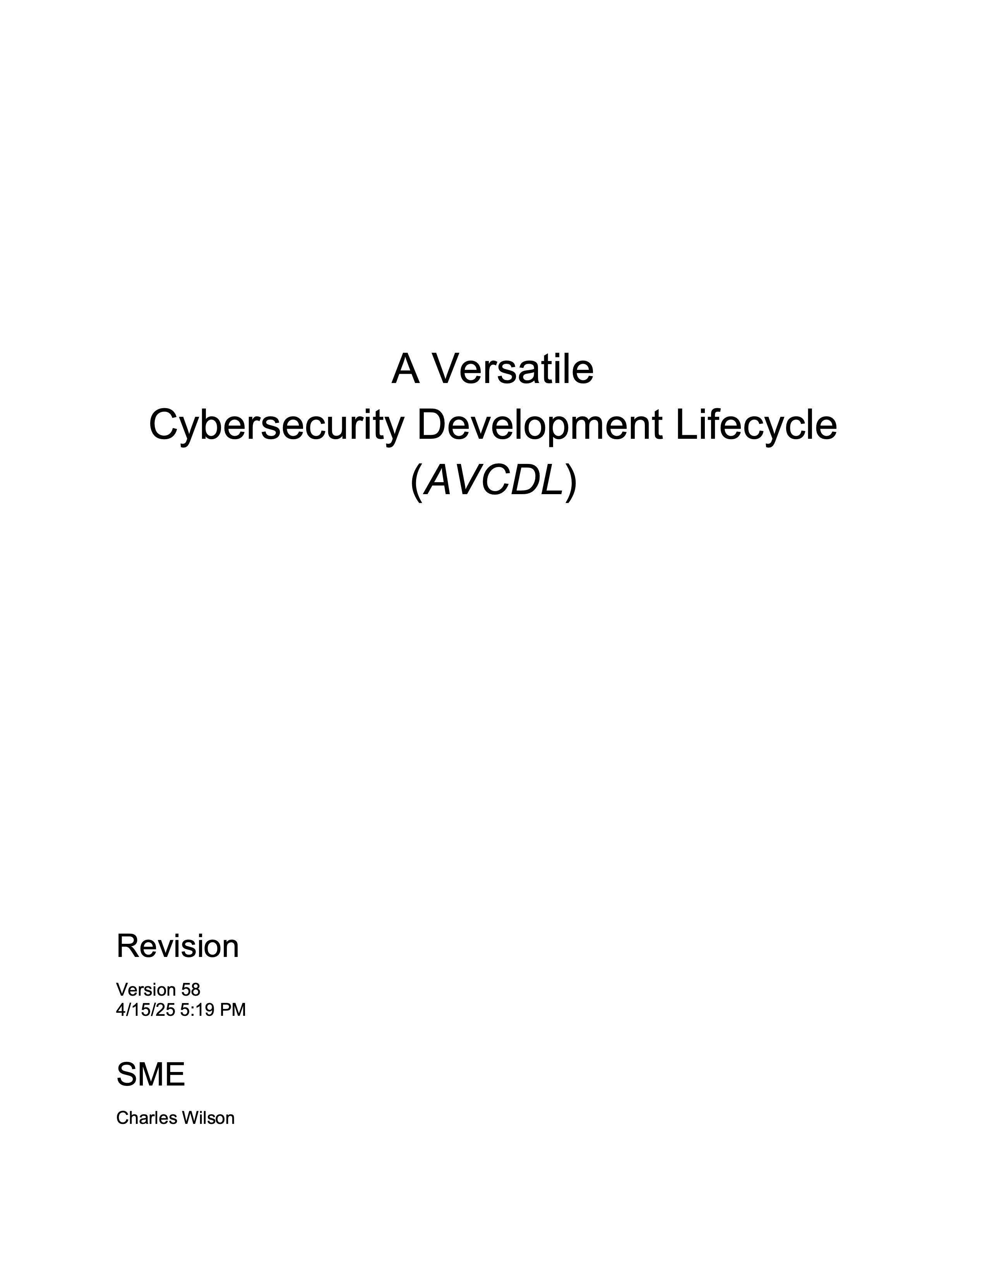
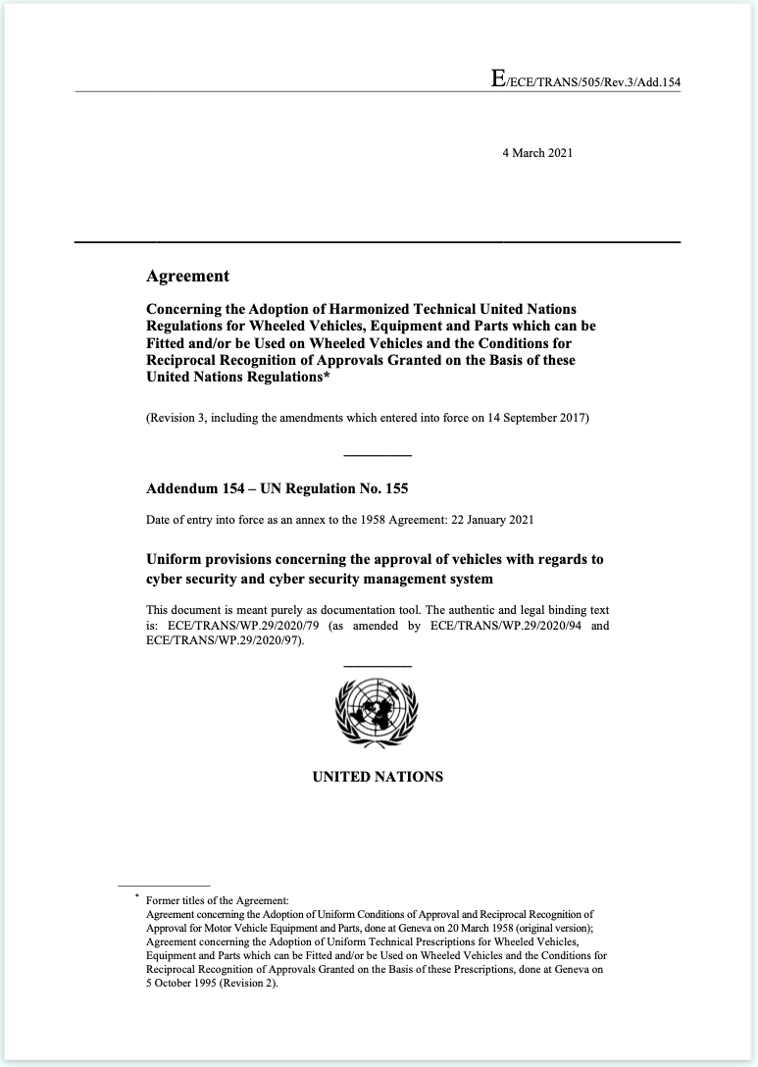
Introduction
Notes:
Script:
The AVCDL is a cybersecurity development lifecycle designed to address the needs of safety-critical cyber-physical systems such as those in the automotive industry where in recent years we've seen the introduction of increasingly sophisticated computer-based systems.
This has led to the creation of a number technical and regulatory standards intended to address the cybersecurity concerns these systems present.
Most notably are ISO/SAE 21434 related to cybersecurity engineering for road vehicles and UN R155 regarding road vehicle cybersecurity.
Let's take a moment to look at the greater cybersecurity standards and regulations ecosystem.

Slide 3
Cybersecurity Standards and Regulations Ecosystem
EU Ares Proposal
(ADS)
Automated Driving Systems will require conformance to R155 and R156
UN R157
(ALKS)
Auto Lane Keeping Systems must conform to R155 and R156
UN R156 (SUMS)
Software Update Management Systems aligned with 24089 and 21434
ISO 24089
(software update)
UN R155 (CSMS)
Cybersecurity Management Systems aligned with 21434
ISO/SAE 21434
(CySec engineering)
ISO 12207 (SDLC - software)
System and software development lifecycles
ISO 15288 (SDLC - system)
ISO 9001 / IATF 16949 (QMS)
A certified QMS is the basis for compliance
Standard
Regulation
Future
Notes:
Script:
Here's a view of the cybersecurity standards and regulations ecosystem.
There's a lot going on here.
In blue, we have technical standards.
These relate to what needs to happen from an engineering standpoint.
In white are activities that we need to do during the creation of the products.
Shown here are United Nations regulations.
Finally, in gray we have future regulation currently under development.
Starting from the bottom, we have the ISO 9000 series which is basically the QMS and related document management system elements.
Atop that, we have two standards that related to systems and software engineering.
And finally, we get to the cybersecurity blocks within the automotive space, dealing with cybersecurity engineering and software update.
These two have corresponding UN regulations for the cybersecurity management system and the software update management system.
Later regulations are dependent on the earlier ones.
And so, the one for the auto lane keeping system, R157 requires that you conform to R155 and R156.
And the same is true with the proposed European Union proposal, which will probably be rolled into the UN regulations in the future for autonomous driving systems.
This proliferation of standards and regulations is the problem that the AVCDL is trying to deal with and avoid.
The AVCDL provides a set of manageable, comprehensible activities from the standpoint of development, project management and safety that fulfill all the various requirements and regulations without the need for getting into the weeds of the specifics of ISO, SAE, or UN language.
Let's take a step back now and ask ourselves what is a lifecycle?

Slide 4
Lifecycle Basics
Policy
Why
Process
What / Who / When
Procedure
How
Notes:
Script:
To understand a lifecycle, it's important to first organize the space that the lifecycle occupies.
We start with policy because policy tells us why we do things.
Policies motivate our actions.
The next level down are processes.
These are the what, who, and when that allow us to implement those policies.
Finally, we have procedures. These are the how.
Procedures are very specific. They take a generic process and provide concrete steps as to how to implement it.
[break]
A lifecycle is the collection of processes and can be applied across multiple different domains and allows us to have dependencies that go across the entirety of the supply chain.
Note that procedures are not part of the lifecycle, because they are specific and unique to each organization implementing the processes.

Slide 5
Lifecycle Basics
Policy
Why
Lifecycle
Process
What / Who / When
Procedure
How
Notes:
Script:
To understand a lifecycle, it's important to first organize the space that the lifecycle occupies.
We start with policy because policy tells us why we do things.
Policies motivate our actions.
The next level down are processes.
These are the what, who, and when that allow us to implement those policies.
Finally, we have procedures. These are the how.
Procedures are very specific. They take a generic process and provide concrete steps as to how to implement it.
[break]
A lifecycle is the collection of processes and can be applied across multiple different domains and allows us to have dependencies that go across the entirety of the supply chain.
Note that procedures are not part of the lifecycle, because they are specific and unique to each organization implementing the processes.

Slide 6
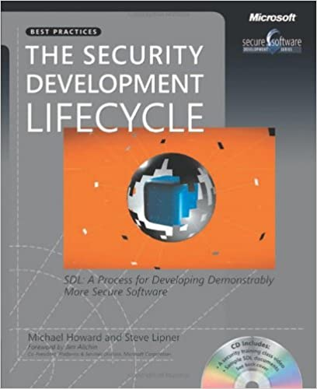
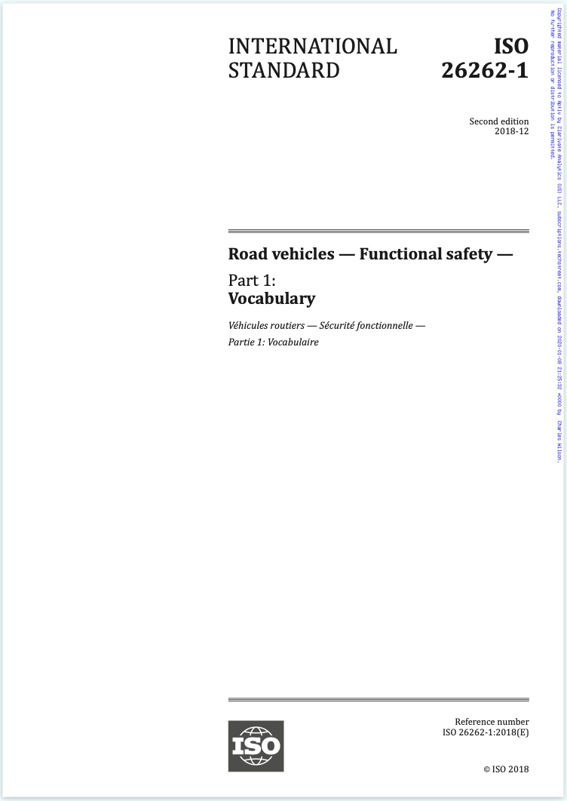
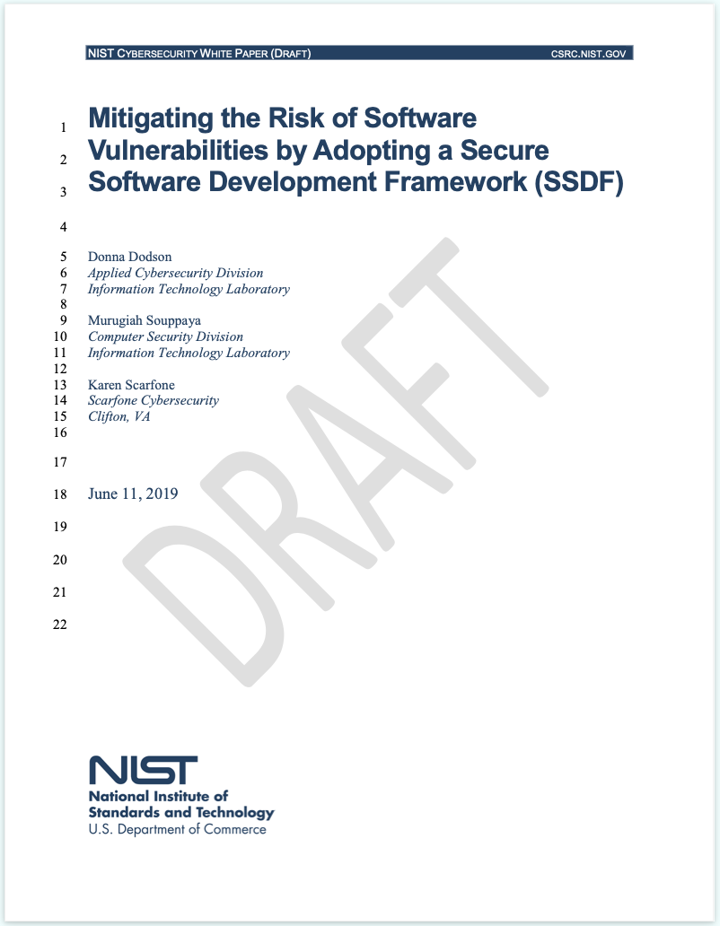
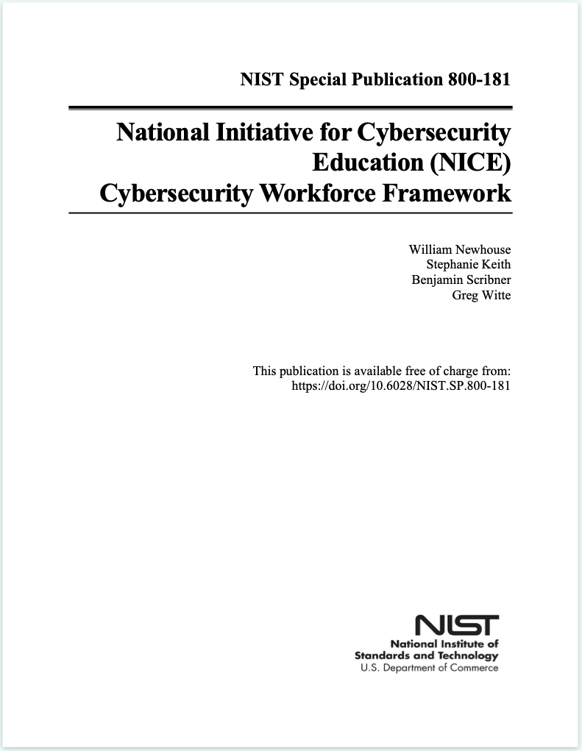
Fundamental References
Notes:
Script:
Although the AVCDL addresses the requirements of ISO/SAE 21434 and UN R155 it's not tied to those specifically.
What we're achieving is compliance, not conformance to make this flexible and not have to return to it every time someone produces a new standard.
The AVCDL takes into consideration two distinct groups of fundamental references.
The first are the ones that we've mentioned before.
And in that collection is also iso 26262 for safety.
On the other half of the equation, we have engineering principles and for that, we look to things like Microsoft's security development lifecycle and the best practices that have come out of NIST and were informed by the qualifications for people who do cybersecurity activities.
And it's this collection of material that has allowed us to create a life cycle which will fulfill all the needs that we have for standards of regulations, but also works with best practices and integrates cleanly.

Slide 7
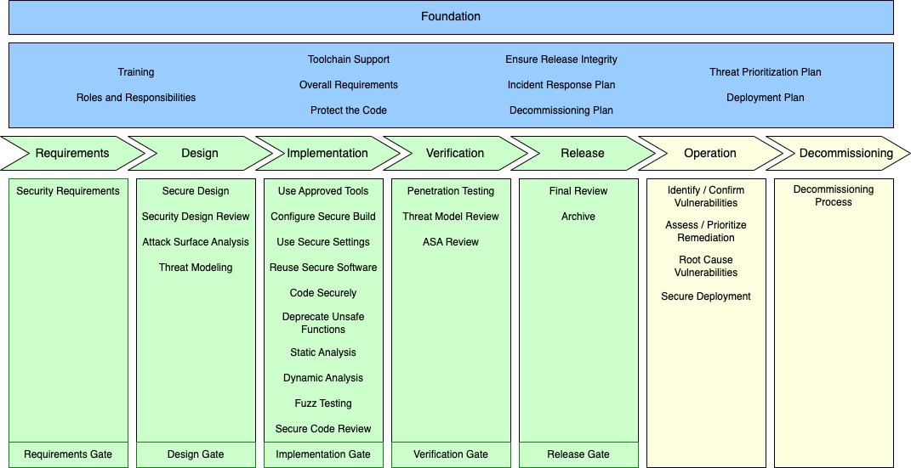
AVCDL Framework
Notes:
Script:
Here's an overview diagram of the AVCDL framework itself.
It has roughly 70 processes spread across eight phases.
[break]
These are foundation, requirements, design, implementation, verification, release, operation, and decommissioning.
They’re collected into three groups.
[break]
The first, the foundation phase contains those processes we do across the entirety of the product line.
We established these processes once and apply to every project.
For instance, when you're talking about roles and responsibilities, those on a product-by-product basis.
The same is true for the overall requirements, tool chain support, or incident response.
[break]
The next group contain the inter-developmental phases.
These are the build-the-product phases. They follow the same general pattern as a standard development lifecycle where we have requirements, design, implementation, verification and release phases.
[break]
Finally, the post-developmental phases include operation and decommissioning.
This is where we're handling the product once it’s been released.
And it's also where we handle retiring the product, whether permanently or for RMA. We have to consider the cybersecurity standpoint, including the organizational IP and cryptographic materials in the device. This is regardless of whether we need to send it back to a supplier for repair or retire it from service.
[break]
Taken together, these phases and processes represent the totality of the product lifecycle from a cybersecurity perspective.

Slide 8
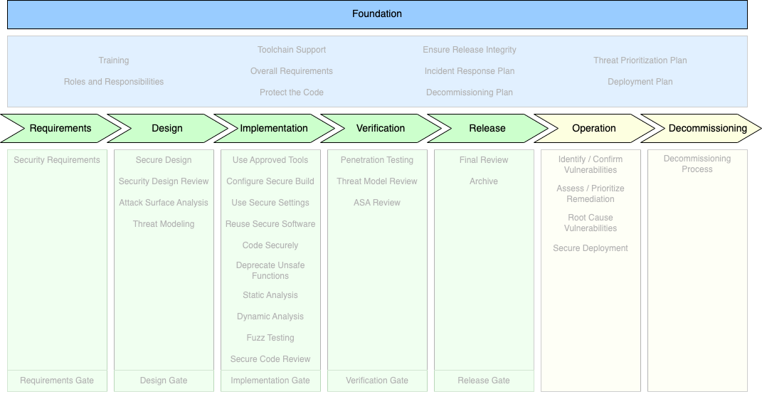
AVCDL Framework
Notes:
Script:
Here's an overview diagram of the AVCDL framework itself.
It has roughly 70 processes spread across eight phases.
[break]
These are foundation, requirements, design, implementation, verification, release, operation, and decommissioning.
They’re collected into three groups.
[break]
The first, the foundation phase contains those processes we do across the entirety of the product line.
We established these processes once and apply to every project.
For instance, when you're talking about roles and responsibilities, those on a product-by-product basis.
The same is true for the overall requirements, tool chain support, or incident response.
[break]
The next group contain the inter-developmental phases.
These are the build-the-product phases. They follow the same general pattern as a standard development lifecycle where we have requirements, design, implementation, verification and release phases.
[break]
Finally, the post-developmental phases include operation and decommissioning.
This is where we're handling the product once it’s been released.
And it's also where we handle retiring the product, whether permanently or for RMA. We have to consider the cybersecurity standpoint, including the organizational IP and cryptographic materials in the device. This is regardless of whether we need to send it back to a supplier for repair or retire it from service.
[break]
Taken together, these phases and processes represent the totality of the product lifecycle from a cybersecurity perspective.

Slide 9
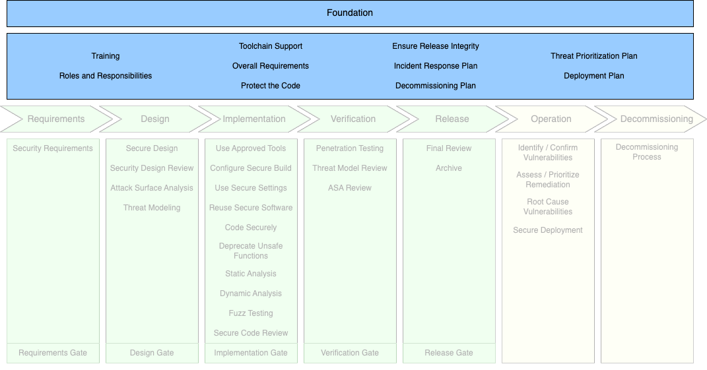
AVCDL Framework – Foundation Phase
Notes:
Script:
Here's an overview diagram of the AVCDL framework itself.
It has roughly 70 processes spread across eight phases.
[break]
These are foundation, requirements, design, implementation, verification, release, operation, and decommissioning.
They’re collected into three groups.
[break]
The first, the foundation phase contains those processes we do across the entirety of the product line.
We established these processes once and apply to every project.
For instance, when you're talking about roles and responsibilities, those on a product-by-product basis.
The same is true for the overall requirements, tool chain support, or incident response.
[break]
The next group contain the inter-developmental phases.
These are the build-the-product phases. They follow the same general pattern as a standard development lifecycle where we have requirements, design, implementation, verification and release phases.
[break]
Finally, the post-developmental phases include operation and decommissioning.
This is where we're handling the product once it’s been released.
And it's also where we handle retiring the product, whether permanently or for RMA. We have to consider the cybersecurity standpoint, including the organizational IP and cryptographic materials in the device. This is regardless of whether we need to send it back to a supplier for repair or retire it from service.
[break]
Taken together, these phases and processes represent the totality of the product lifecycle from a cybersecurity perspective.

Slide 10
AVCDL Framework – Intra-developmental Phases
Notes:
Script:
Here's an overview diagram of the AVCDL framework itself.
It has roughly 70 processes spread across eight phases.
[break]
These are foundation, requirements, design, implementation, verification, release, operation, and decommissioning.
They’re collected into three groups.
[break]
The first, the foundation phase contains those processes we do across the entirety of the product line.
We established these processes once and apply to every project.
For instance, when you're talking about roles and responsibilities, those on a product-by-product basis.
The same is true for the overall requirements, tool chain support, or incident response.
[break]
The next group contain the inter-developmental phases.
These are the build-the-product phases. They follow the same general pattern as a standard development lifecycle where we have requirements, design, implementation, verification and release phases.
[break]
Finally, the post-developmental phases include operation and decommissioning.
This is where we're handling the product once it’s been released.
And it's also where we handle retiring the product, whether permanently or for RMA. We have to consider the cybersecurity standpoint, including the organizational IP and cryptographic materials in the device. This is regardless of whether we need to send it back to a supplier for repair or retire it from service.
[break]
Taken together, these phases and processes represent the totality of the product lifecycle from a cybersecurity perspective.

Slide 11
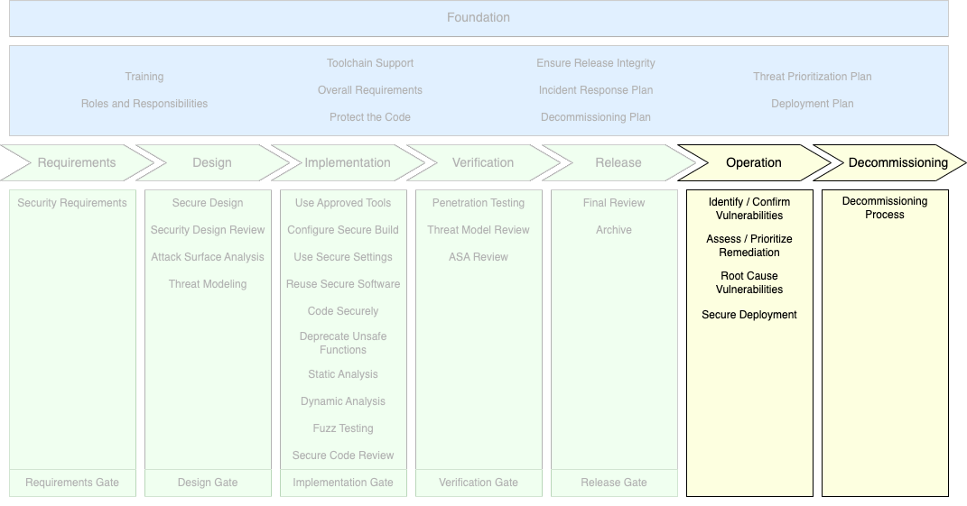
AVCDL Framework – Post-developmental Phases
Notes:
Script:
Here's an overview diagram of the AVCDL framework itself.
It has roughly 70 processes spread across eight phases.
[break]
These are foundation, requirements, design, implementation, verification, release, operation, and decommissioning.
They’re collected into three groups.
[break]
The first, the foundation phase contains those processes we do across the entirety of the product line.
We established these processes once and apply to every project.
For instance, when you're talking about roles and responsibilities, those on a product-by-product basis.
The same is true for the overall requirements, tool chain support, or incident response.
[break]
The next group contain the inter-developmental phases.
These are the build-the-product phases. They follow the same general pattern as a standard development lifecycle where we have requirements, design, implementation, verification and release phases.
[break]
Finally, the post-developmental phases include operation and decommissioning.
This is where we're handling the product once it’s been released.
And it's also where we handle retiring the product, whether permanently or for RMA. We have to consider the cybersecurity standpoint, including the organizational IP and cryptographic materials in the device. This is regardless of whether we need to send it back to a supplier for repair or retire it from service.
[break]
Taken together, these phases and processes represent the totality of the product lifecycle from a cybersecurity perspective.

Slide 12
Design Deficiencies vs Implementation Defects
Notes:
Script:
One might look at the AVCDL and think that there are a lot of activities there.
Do we really need all these activities to ensure cybersecurity for the product?
That's a good question.
Let's look at two areas that we think about in a realm known as defense-in-depth that we base our choice for cybersecurity activities on.
These are design deficiencies and implementation defects.
[break]
A classic way to approach cybersecurity within a product is by assessing the product after it's built. This can be done using penetration testing or earlier on in the development process with extensions to what would normally be considered compiler features such as static and dynamic analysis, as well as more sophisticated after-the-fact testing, such as using the analog to unit testing that being fuzz testing.
Additionally, you can have secure code reviews alongside of traditional functional code reviews.
All these activities address implementation defects.
These are where the system itself has implemented cybersecurity related elements incorrectly.
[break]
A more sophisticated approach allows us to address design deficiencies where the elements of the system were not designed taking cybersecurity into consideration.
Here, we use activities like security design reviews, attack surface analysis and threat modeling.
You'll notice that there're duals of these last two activities in the verification phase where we perform a threat modeling review and an attack surface analysis review.
This allows us to ensure that the deficiencies identified in the design phase were in fact addressed by the time we get to the verification phase.
[break]
It's the combination of these two approaches addressing both the design deficiencies and the implementation defects that give us the highest level of certainty that we've managed to attain sufficient cybersecurity rigor.

Slide 13
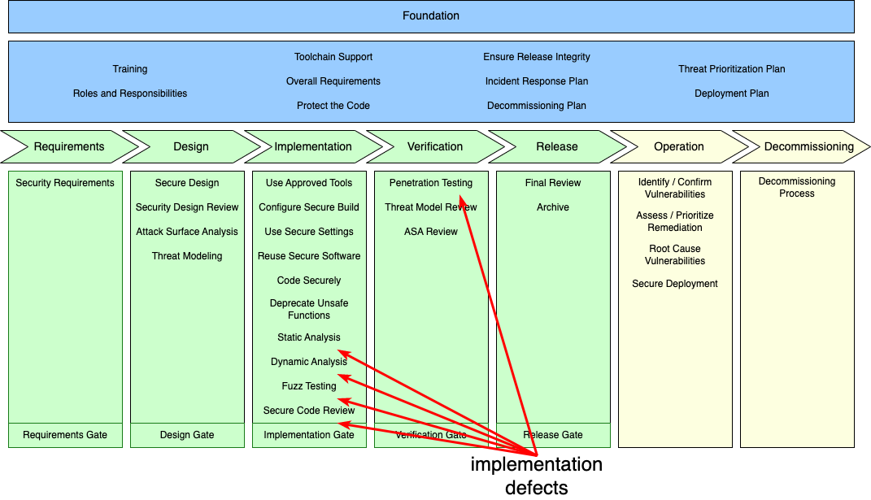
Design Deficiencies vs Implementation Defects
Notes:
Script:
One might look at the AVCDL and think that there are a lot of activities there.
Do we really need all these activities to ensure cybersecurity for the product?
That's a good question.
Let's look at two areas that we think about in a realm known as defense-in-depth that we base our choice for cybersecurity activities on.
These are design deficiencies and implementation defects.
[break]
A classic way to approach cybersecurity within a product is by assessing the product after it's built. This can be done using penetration testing or earlier on in the development process with extensions to what would normally be considered compiler features such as static and dynamic analysis, as well as more sophisticated after-the-fact testing, such as using the analog to unit testing that being fuzz testing.
Additionally, you can have secure code reviews alongside of traditional functional code reviews.
All these activities address implementation defects.
These are where the system itself has implemented cybersecurity related elements incorrectly.
[break]
A more sophisticated approach allows us to address design deficiencies where the elements of the system were not designed taking cybersecurity into consideration.
Here, we use activities like security design reviews, attack surface analysis and threat modeling.
You'll notice that there're duals of these last two activities in the verification phase where we perform a threat modeling review and an attack surface analysis review.
This allows us to ensure that the deficiencies identified in the design phase were in fact addressed by the time we get to the verification phase.
[break]
It's the combination of these two approaches addressing both the design deficiencies and the implementation defects that give us the highest level of certainty that we've managed to attain sufficient cybersecurity rigor.

Slide 14
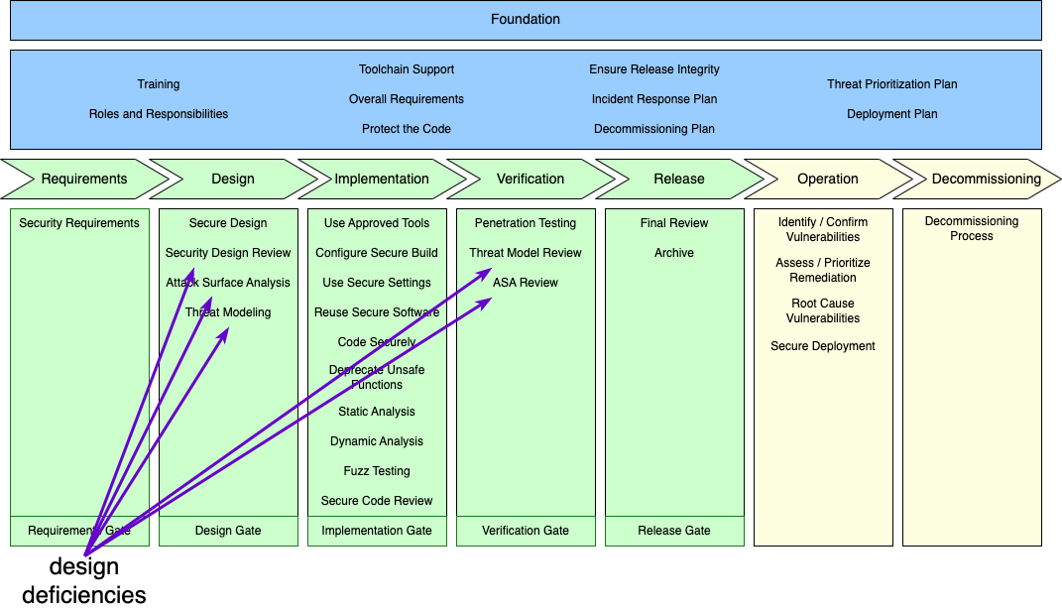
Design Deficiencies vs Implementation Defects
Notes:
Script:
One might look at the AVCDL and think that there are a lot of activities there.
Do we really need all these activities to ensure cybersecurity for the product?
That's a good question.
Let's look at two areas that we think about in a realm known as defense-in-depth that we base our choice for cybersecurity activities on.
These are design deficiencies and implementation defects.
[break]
A classic way to approach cybersecurity within a product is by assessing the product after it's built. This can be done using penetration testing or earlier on in the development process with extensions to what would normally be considered compiler features such as static and dynamic analysis, as well as more sophisticated after-the-fact testing, such as using the analog to unit testing that being fuzz testing.
Additionally, you can have secure code reviews alongside of traditional functional code reviews.
All these activities address implementation defects.
These are where the system itself has implemented cybersecurity related elements incorrectly.
[break]
A more sophisticated approach allows us to address design deficiencies where the elements of the system were not designed taking cybersecurity into consideration.
Here, we use activities like security design reviews, attack surface analysis and threat modeling.
You'll notice that there're duals of these last two activities in the verification phase where we perform a threat modeling review and an attack surface analysis review.
This allows us to ensure that the deficiencies identified in the design phase were in fact addressed by the time we get to the verification phase.
[break]
It's the combination of these two approaches addressing both the design deficiencies and the implementation defects that give us the highest level of certainty that we've managed to attain sufficient cybersecurity rigor.

Slide 15
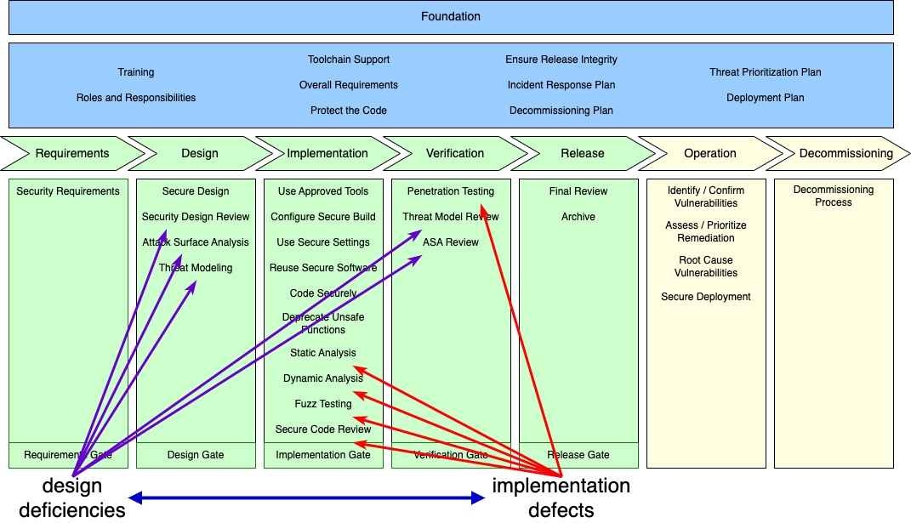
Design Deficiencies vs Implementation Defects
Notes:
Script:
One might look at the AVCDL and think that there are a lot of activities there.
Do we really need all these activities to ensure cybersecurity for the product?
That's a good question.
Let's look at two areas that we think about in a realm known as defense-in-depth that we base our choice for cybersecurity activities on.
These are design deficiencies and implementation defects.
[break]
A classic way to approach cybersecurity within a product is by assessing the product after it's built. This can be done using penetration testing or earlier on in the development process with extensions to what would normally be considered compiler features such as static and dynamic analysis, as well as more sophisticated after-the-fact testing, such as using the analog to unit testing that being fuzz testing.
Additionally, you can have secure code reviews alongside of traditional functional code reviews.
All these activities address implementation defects.
These are where the system itself has implemented cybersecurity related elements incorrectly.
[break]
A more sophisticated approach allows us to address design deficiencies where the elements of the system were not designed taking cybersecurity into consideration.
Here, we use activities like security design reviews, attack surface analysis and threat modeling.
You'll notice that there're duals of these last two activities in the verification phase where we perform a threat modeling review and an attack surface analysis review.
This allows us to ensure that the deficiencies identified in the design phase were in fact addressed by the time we get to the verification phase.
[break]
It's the combination of these two approaches addressing both the design deficiencies and the implementation defects that give us the highest level of certainty that we've managed to attain sufficient cybersecurity rigor.

Slide 16
Mitigation Cost Multiplier
Boehm 1976
0.2 0.5 1.2 15
1 90 - 440 470 - 880
Baziuk 1995
Notes:
Script:
This dual approach of looking at deficiencies separately from defects also has the advantage that it is far more cost effective to find and correct issues early on.
As opposed to later, as illustrated here in these two overlays, one was done in 1976 and the other in 1995 estimating the cost of mitigating a discovered defect in the code.
And as you can see the 1995 data, which is far more in depth in terms of the the material they had to draw on.
if we're fixing things in the implementation and verification phase, we are spending, you know, 100 to 500.
And by the time we get out to of the release product, nearly 900 times the amount that we would have spent had we made the correction in the design phase.

Slide 17
Implementation Methodologies
Notes:
Script:
Let's take a moment to talk about implementation methodologies.
Some people look at this rectilinear representation of the AVCDL framework and say, well that that's a waterfall implementation.
In reality, this representation was chosen because it is the most compact way to present the information showing the different phases, their processes, and how they are grouped together.
It's not a statement about implementation methodology.
In fact, the AVCDL is implementation methodology neutral.
This is an important point because in any highly complex system, such as an autonomous vehicle, there are dozens of components, produced by multiple suppliers, each with their own development processes and implementation methodology. It’s critical to be able to align cybersecurity activities regardless of the particular implementation methodology being used.
Next, we'll look at two specific methodologies which the AVCDL addresses directly.

Slide 18
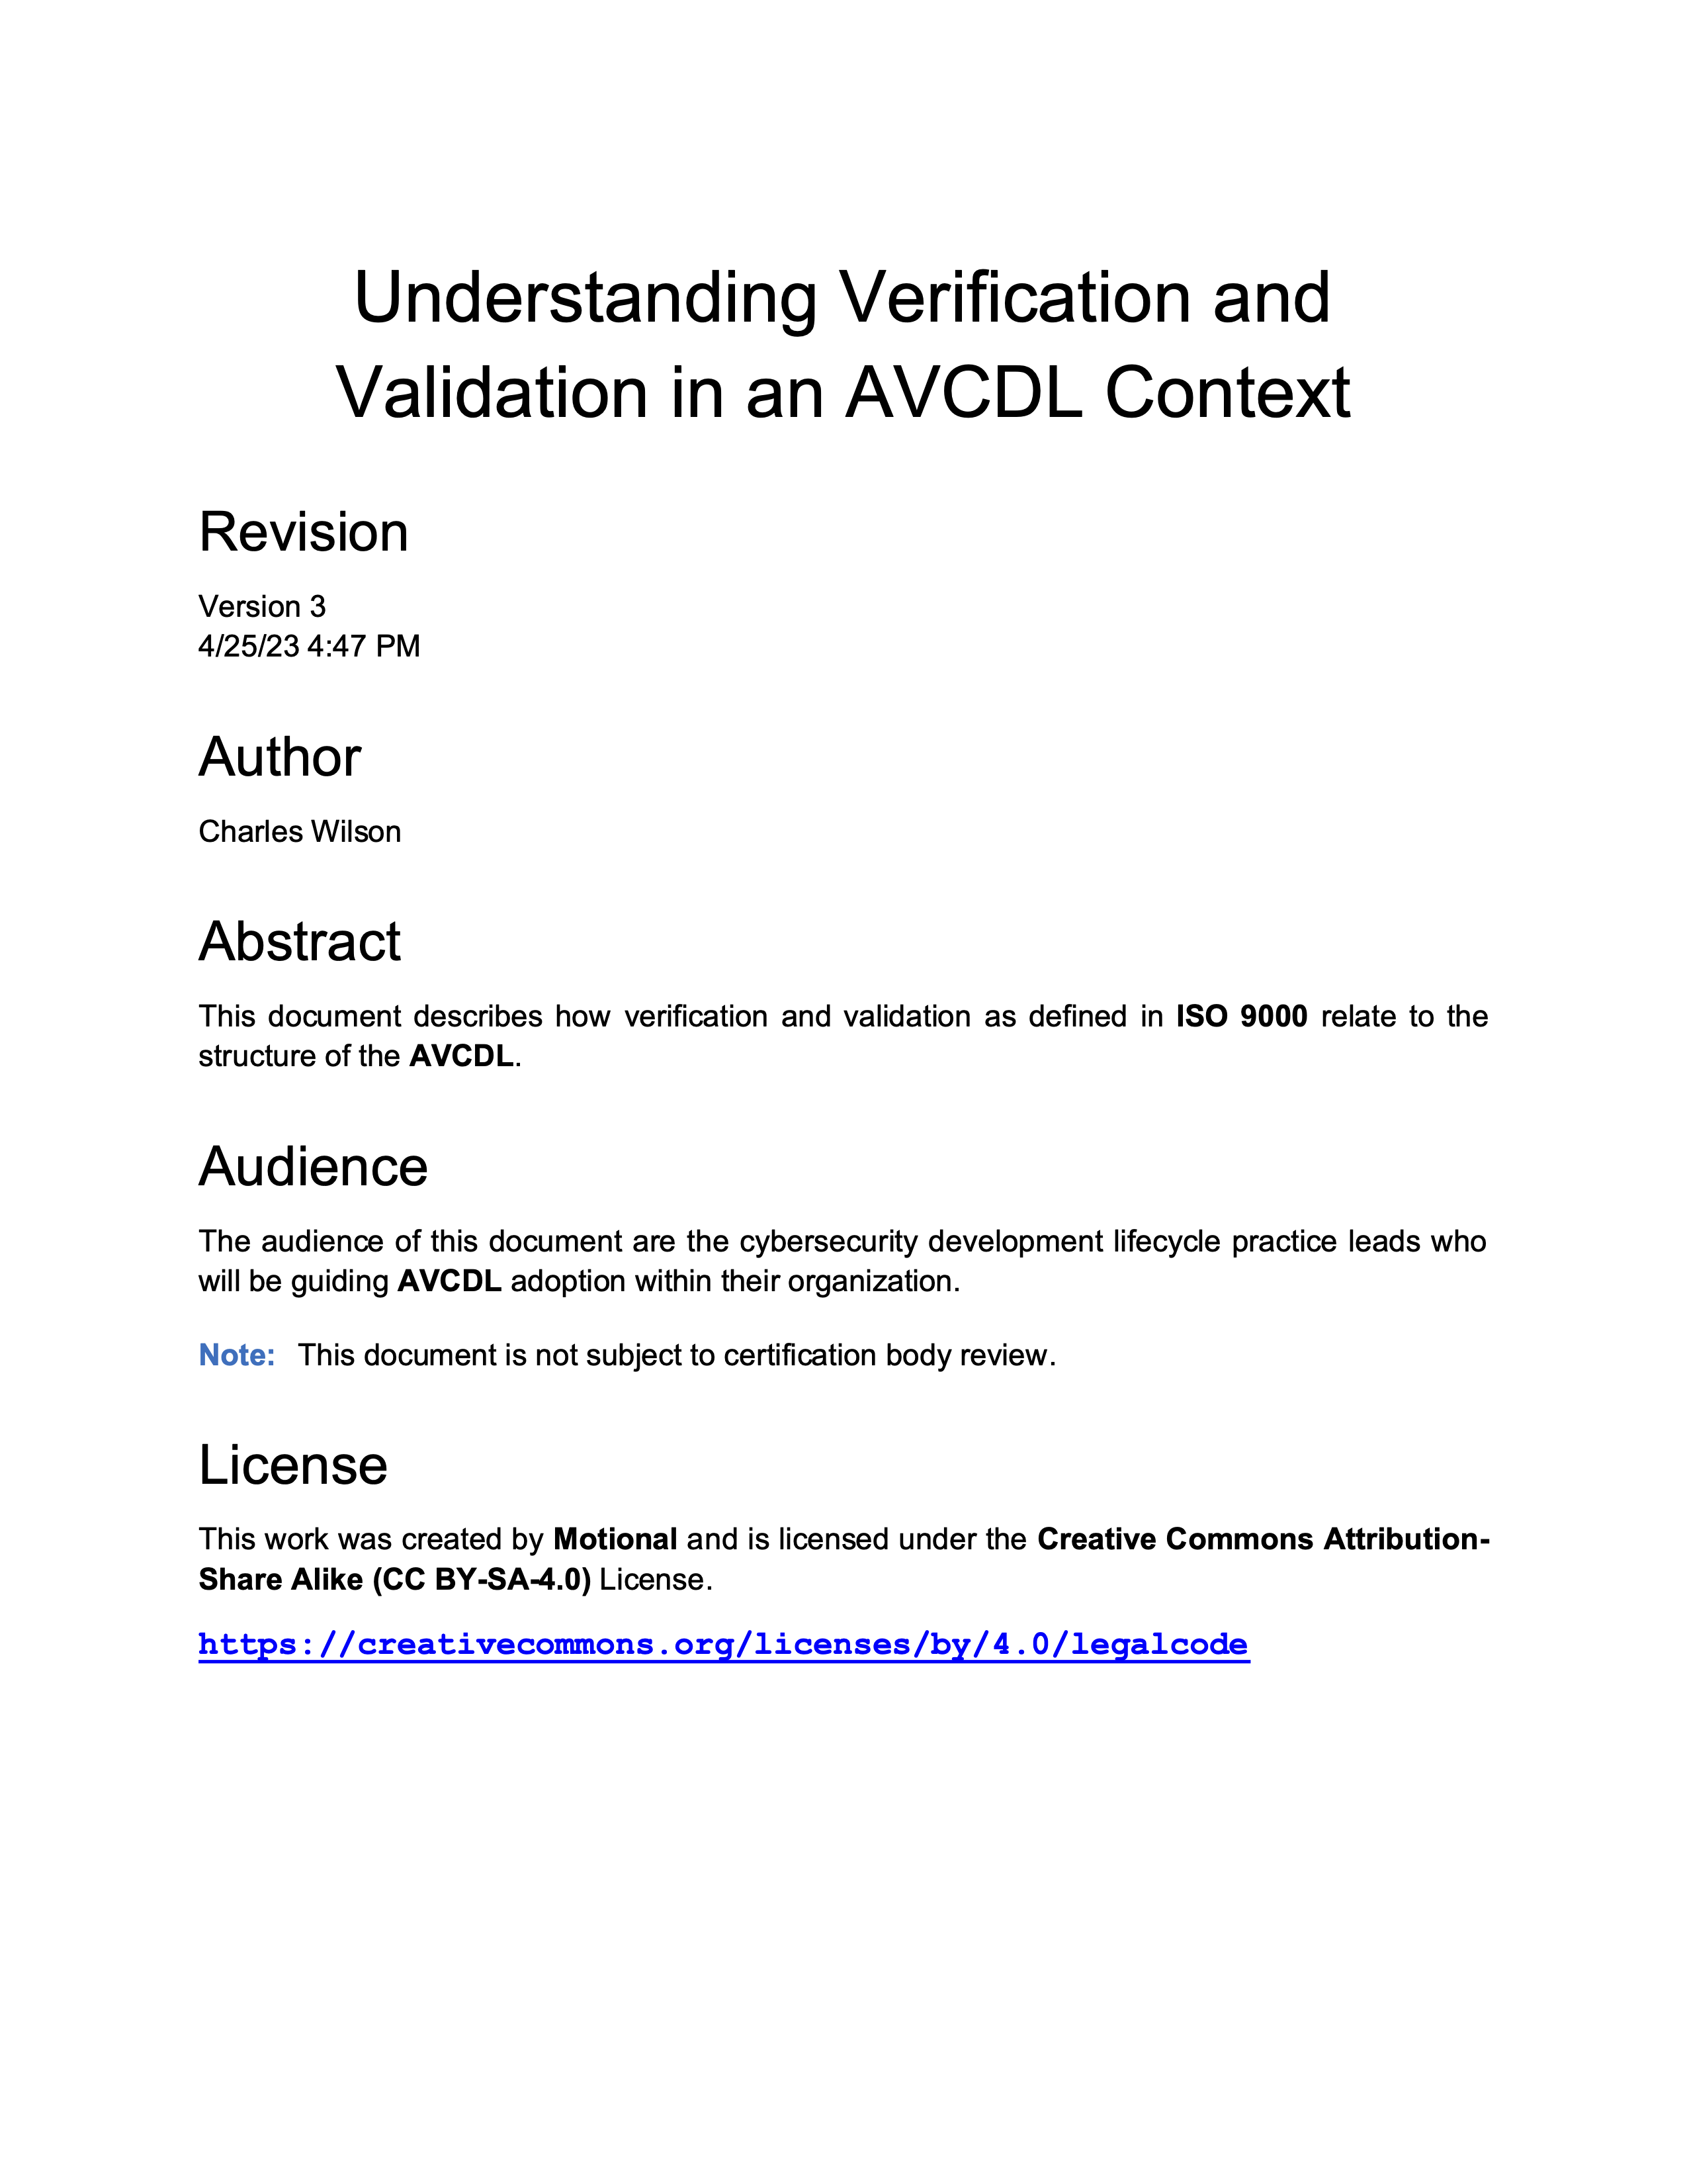
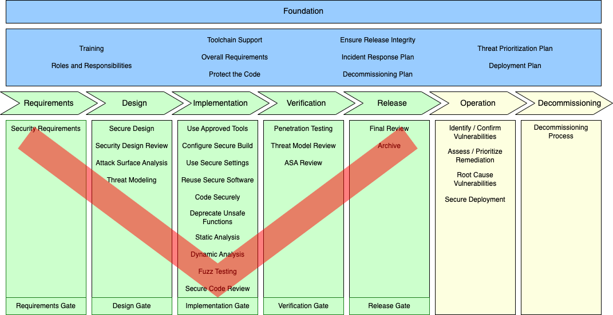
V-model Implementation Methodology
Notes:
Script:
The first methodology is most heavily used by safety groups.
It’s the V-model implementation methodology.
We see it realized in ASPICE and the like. ISO 26262 also leans into this model.
An explanation of how the AVCDL accommodates the V-model is explained in an elaboration document titled Understanding Verification and Validation in an AVCDL Context.

Slide 19
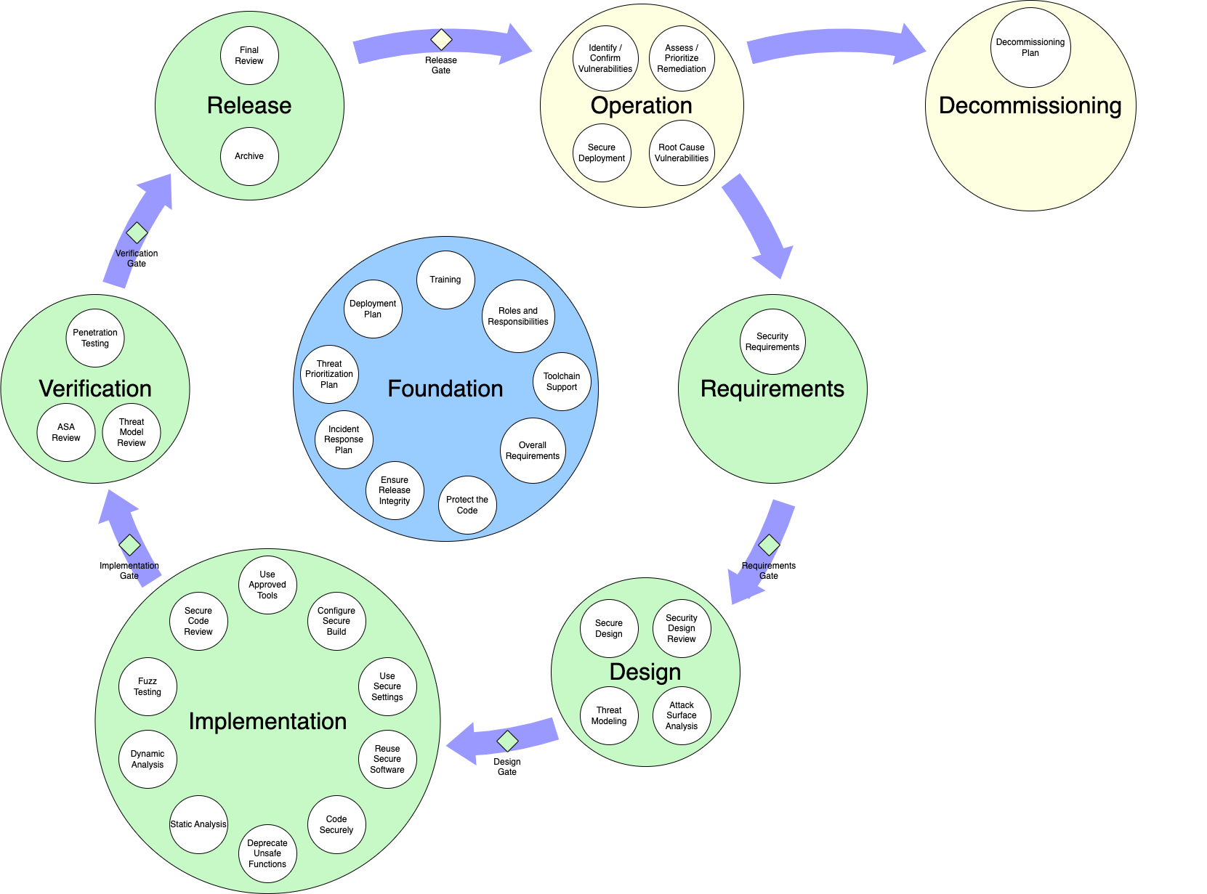
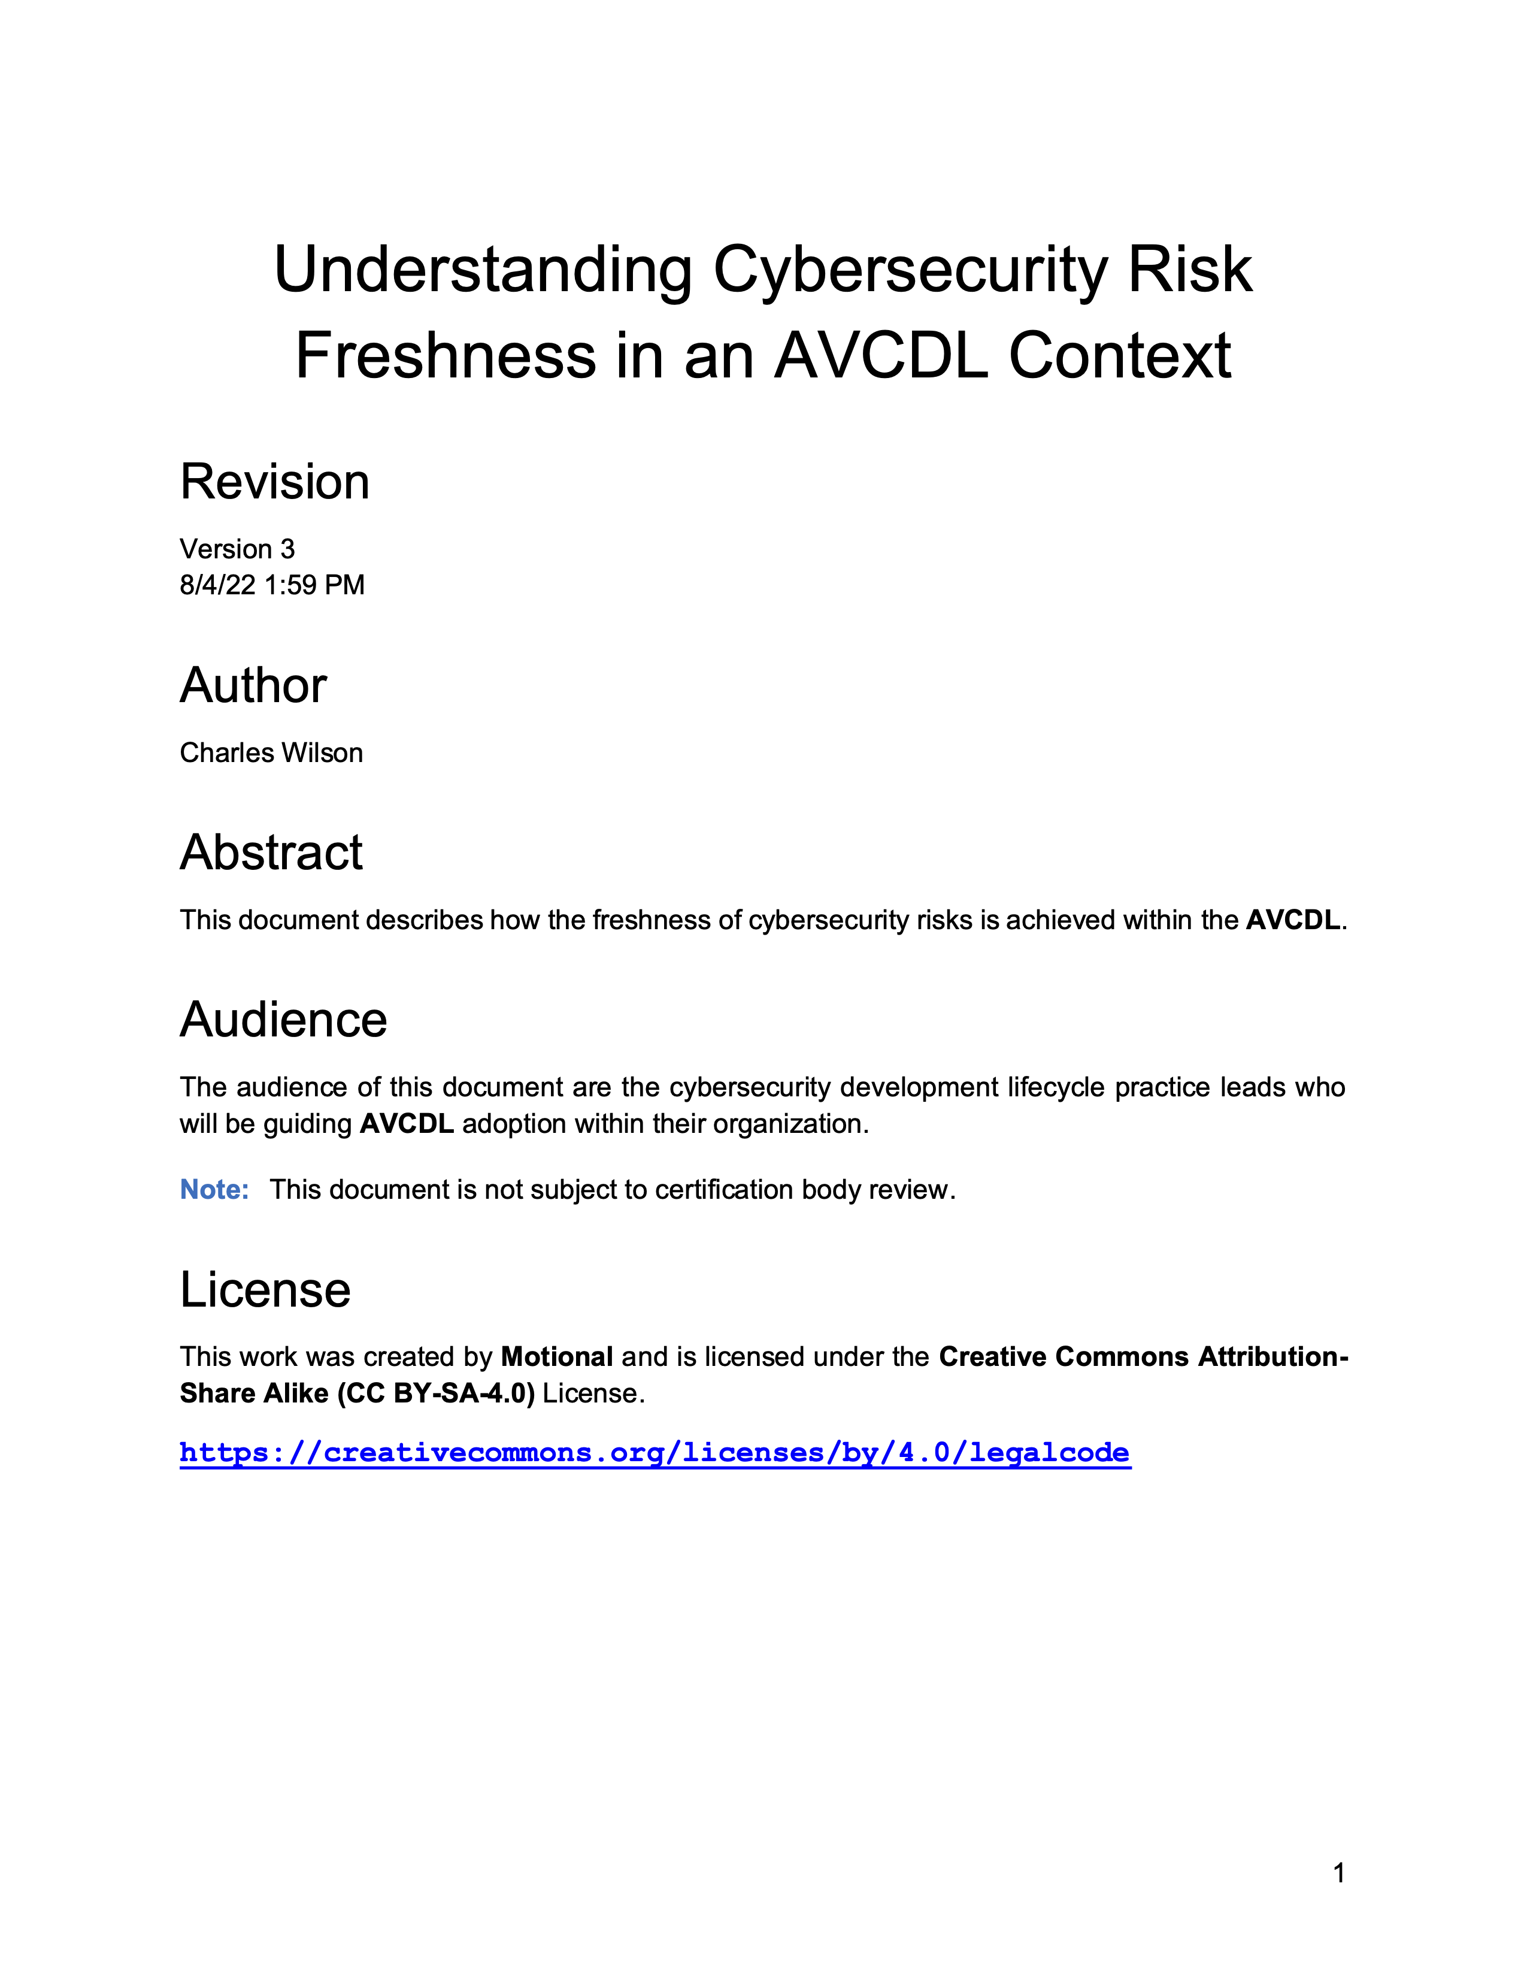
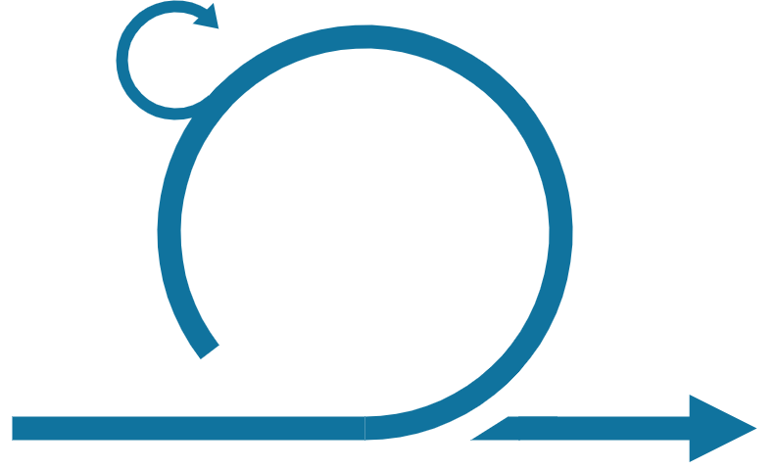
Cyclic Implementation Methodology
Notes:
Script:
The second implementation methodology of note is one which has become a favorite of development, that is the cyclic implementation methodology.
This methodology has actually been around for quite some time. It’s short-cycled and iterative in approach. Two specific realizations are spiral and agile.
What we see here is how the AVCDL framework could be visualized in such an implementation.
There's an elaboration document, Understanding Cybersecurity Risk Freshness in an AVCDL Context, which covers the implications of the cyclic implementation methodology and the feedback loops that go with it.

Slide 20
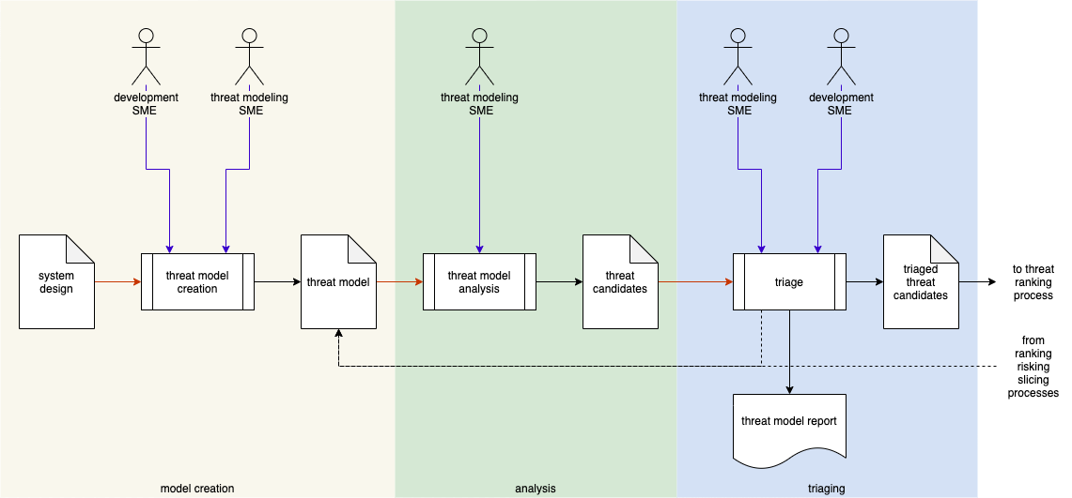
Process Workflows
Notes:
Script:
An important element provided by all AVCDL processes is a workflow diagram like the one shown here.
From the standpoint of project management, this is a useful and important source of information as it enables them to know what individuals and resources will be required, what activities will be undertaken, what outputs, and what reports will be generated by the process.
In this case, what we're looking at is the threat modeling process.
Within this process, we undertake three distinct activities, threat model creation, threat model analysis, and threat candidate triage.
As you can see, we call out the actors, inputs, outputs, and reports.
Additionally, we have optional feedback that may lead to updating the threat model itself.
Once the triage activity is complete, the final artifact is fed into a common threat ranking process.
The documents that include these workflows provide detailed explanations about these activities and what motivates them.
They also provide information about the artifacts and reports, and how they're structured.
All this information is critical to being able to plan and schedule these activities, and also to coordinate the dependencies between groups and for the process overall.

Slide 21
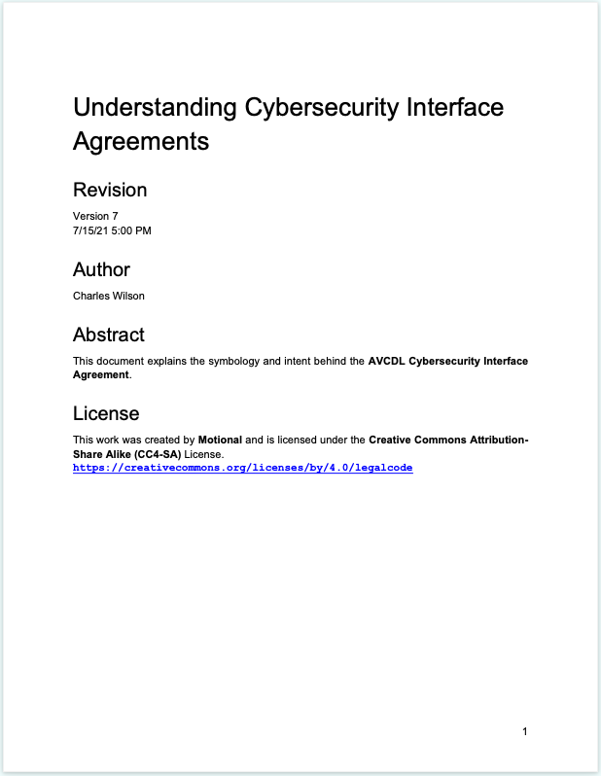
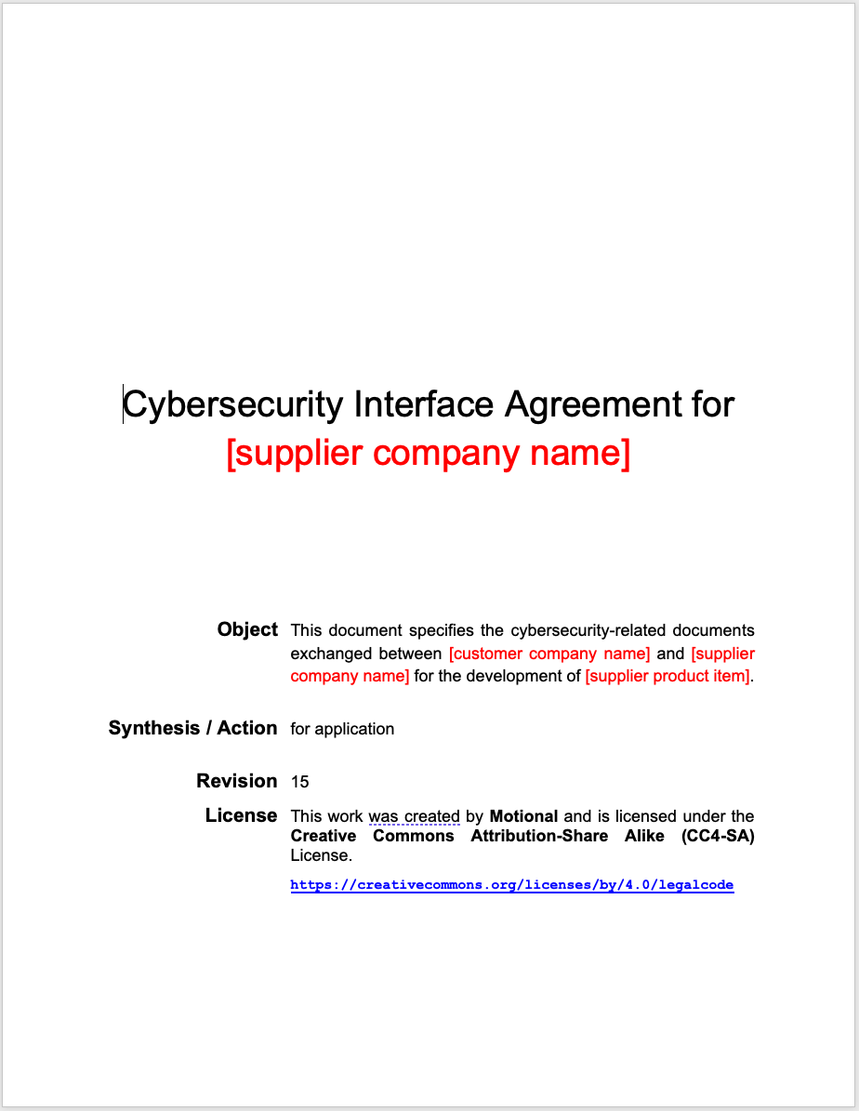
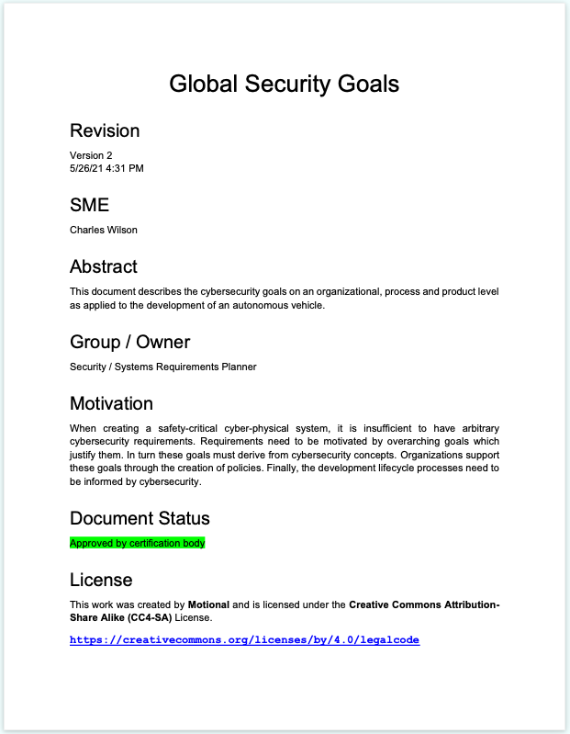
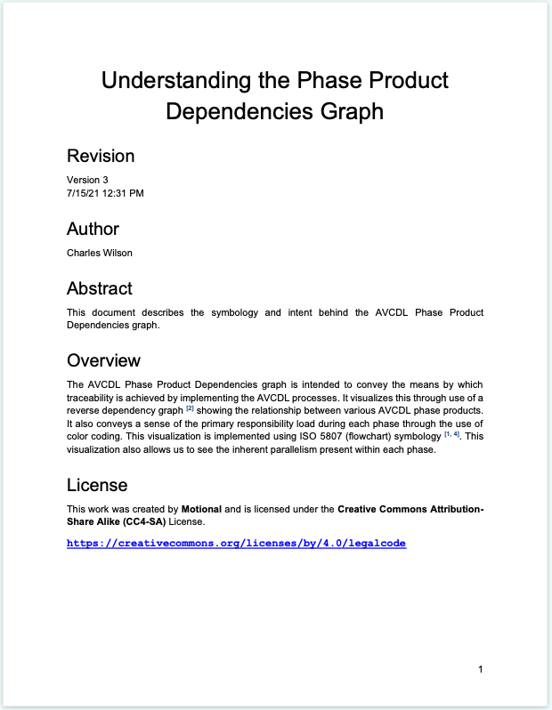
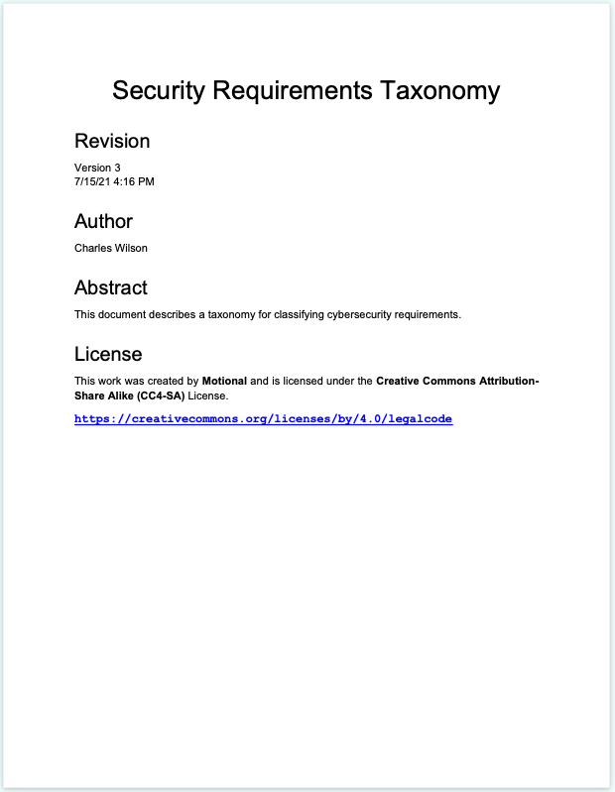
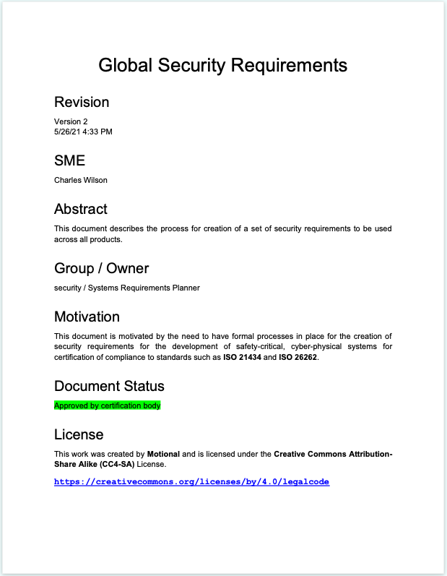
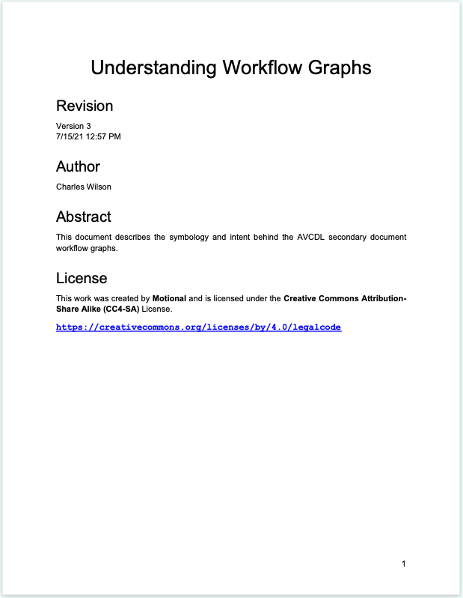
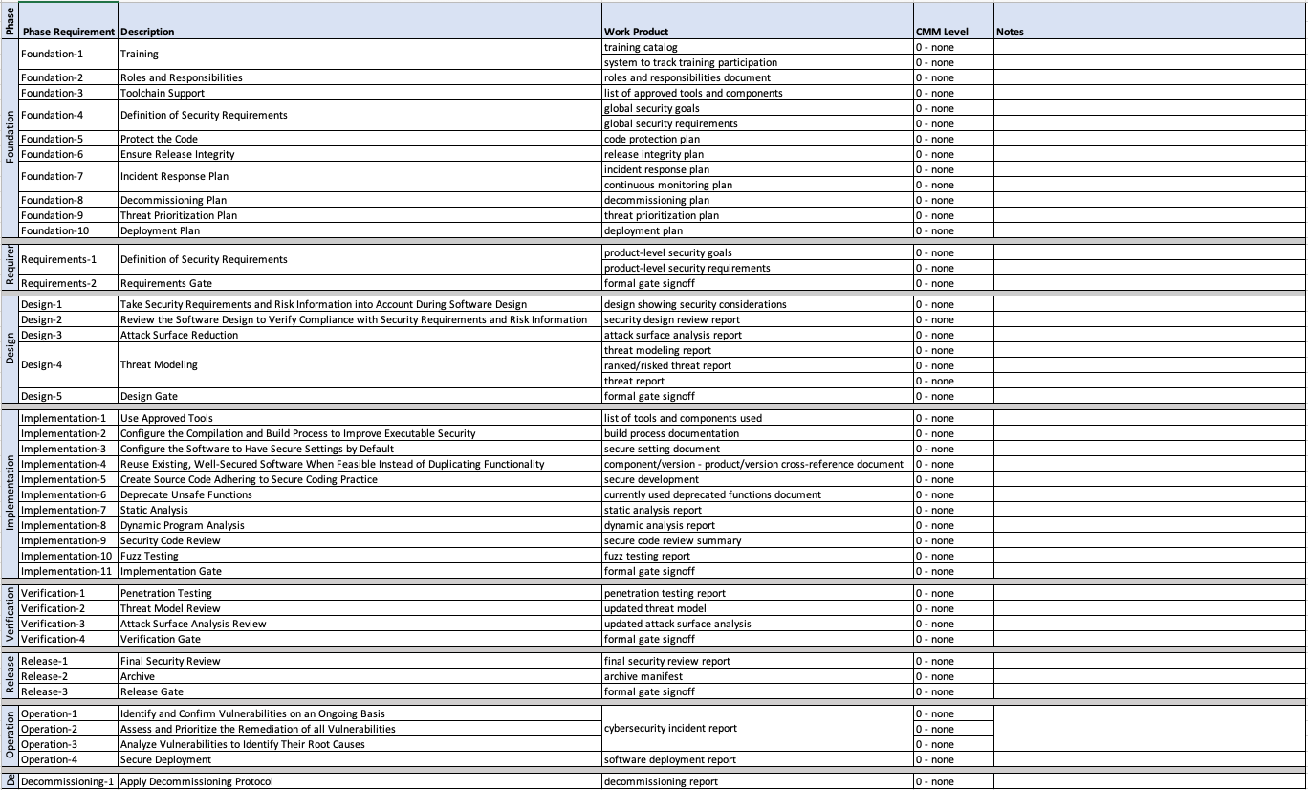
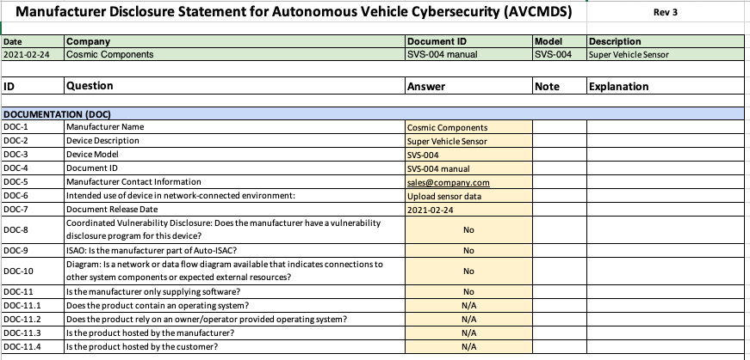
AVCDL Documents
Notes:
Script:
As you might imagine covering an entire cybersecurity development lifecycle requires a lot of explanation.
The AVCDL doesn't simply provide a single huge tome to do so.
It's broken up into many different pieces allowing for both incremental adoption and for focused learning.
The primary document covers the basics of the AVCDL, how it was constructed, what the various goals of the AVCDL are, the requirements for various cybersecurity roles referenced, as well as how each of the phases decomposes into a set of processes.
[break]
A set of secondary and elaboration documents covers each of these processes in detail and provides additional material that help understanding the processes and specific concepts that are used within the AVCDL.
[break]
There's also a set of templates and working materials to assist cybersecurity SMEs in performing the various activities necessary to implement the lifecycle.
[break]
Additionally, it's important to consider that the supply chain is a critical part of cybersecurity engineering.
[break]
And so, there's a set of documents dedicated strictly to the supply chain, including creation of the cybersecurity interface agreement and a set of templates to assist in that process.
[break]
Finally, there is a set of introductory blog posts created to give individuals who don't work in cybersecurity an understanding of various concepts that cybersecurity relies upon to accomplish its mission.

Slide 22
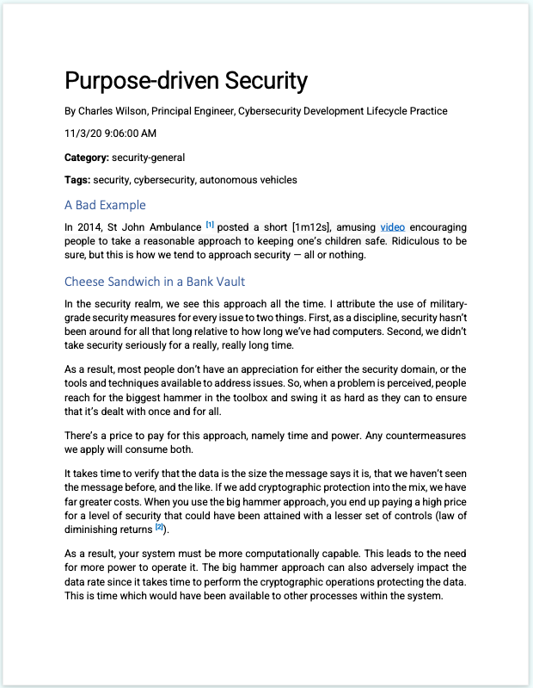
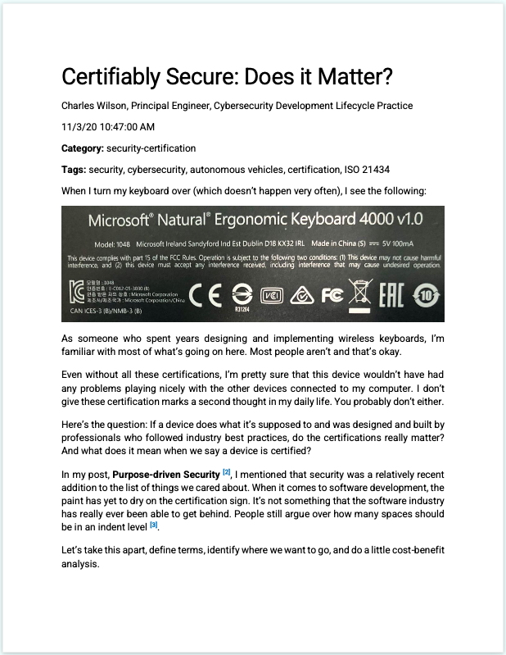
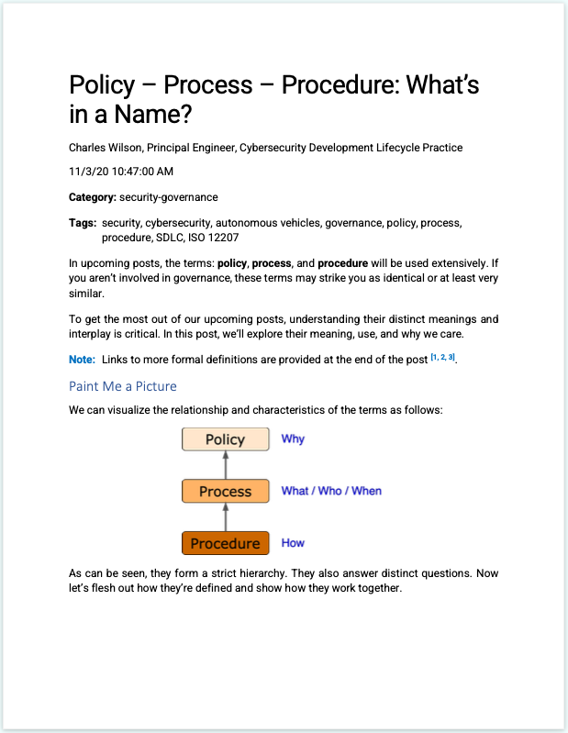
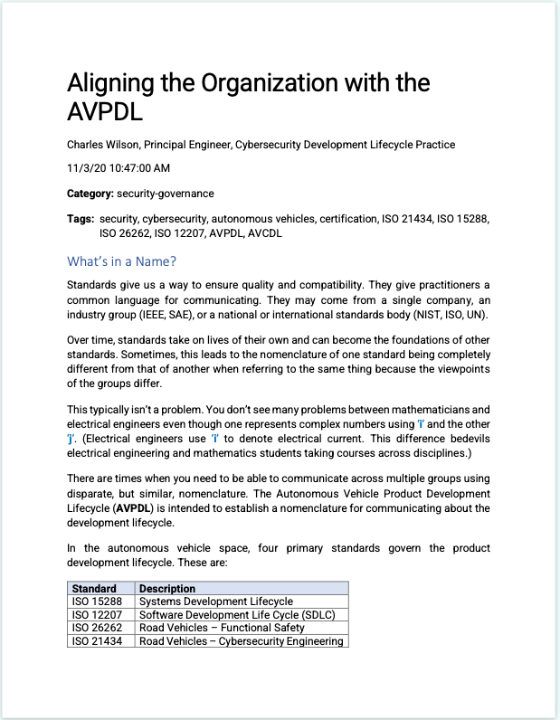
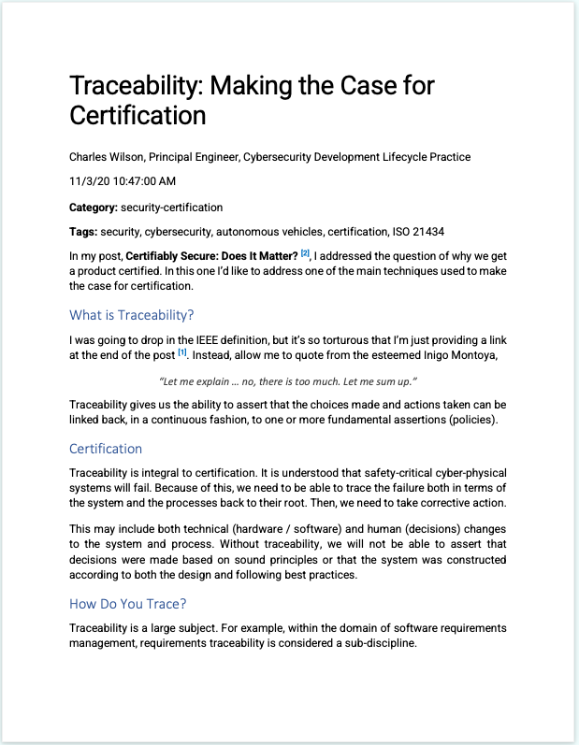
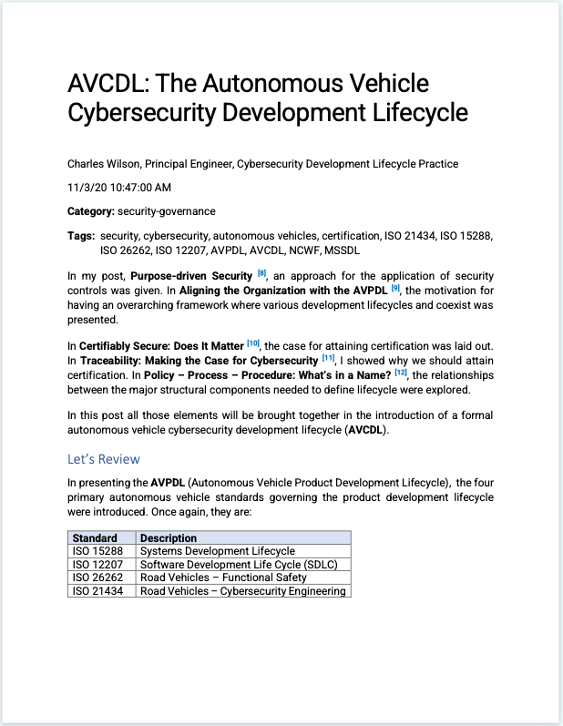
AVCDL Documents
Notes:
Script:
As you might imagine covering an entire cybersecurity development lifecycle requires a lot of explanation.
The AVCDL doesn't simply provide a single huge tome to do so.
It's broken up into many different pieces allowing for both incremental adoption and for focused learning.
The primary document covers the basics of the AVCDL, how it was constructed, what the various goals of the AVCDL are, the requirements for various cybersecurity roles referenced, as well as how each of the phases decomposes into a set of processes.
[break]
A set of secondary and elaboration documents covers each of these processes in detail and provides additional material that help understanding the processes and specific concepts that are used within the AVCDL.
[break]
There's also a set of templates and working materials to assist cybersecurity SMEs in performing the various activities necessary to implement the lifecycle.
[break]
Additionally, it's important to consider that the supply chain is a critical part of cybersecurity engineering.
[break]
And so, there's a set of documents dedicated strictly to the supply chain, including creation of the cybersecurity interface agreement and a set of templates to assist in that process.
[break]
Finally, there is a set of introductory blog posts created to give individuals who don't work in cybersecurity an understanding of various concepts that cybersecurity relies upon to accomplish its mission.

Slide 23
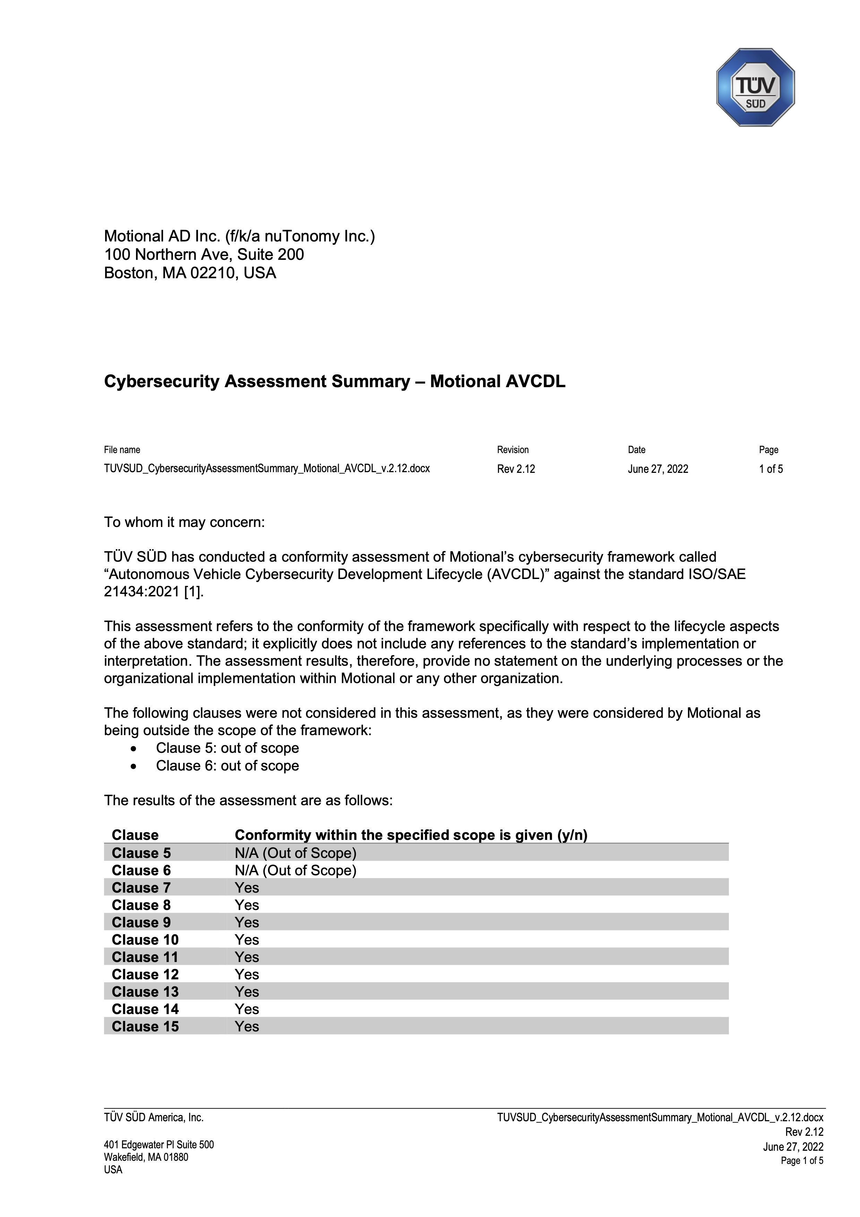
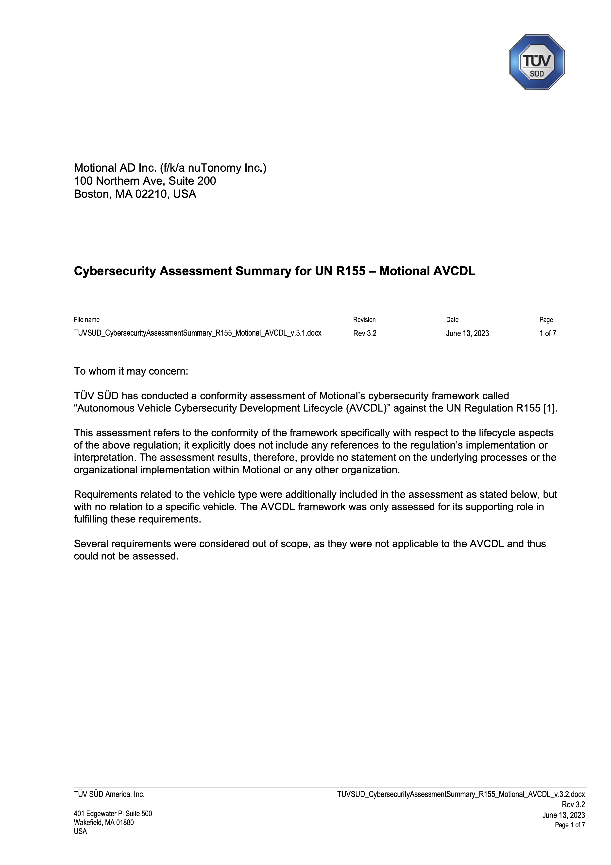
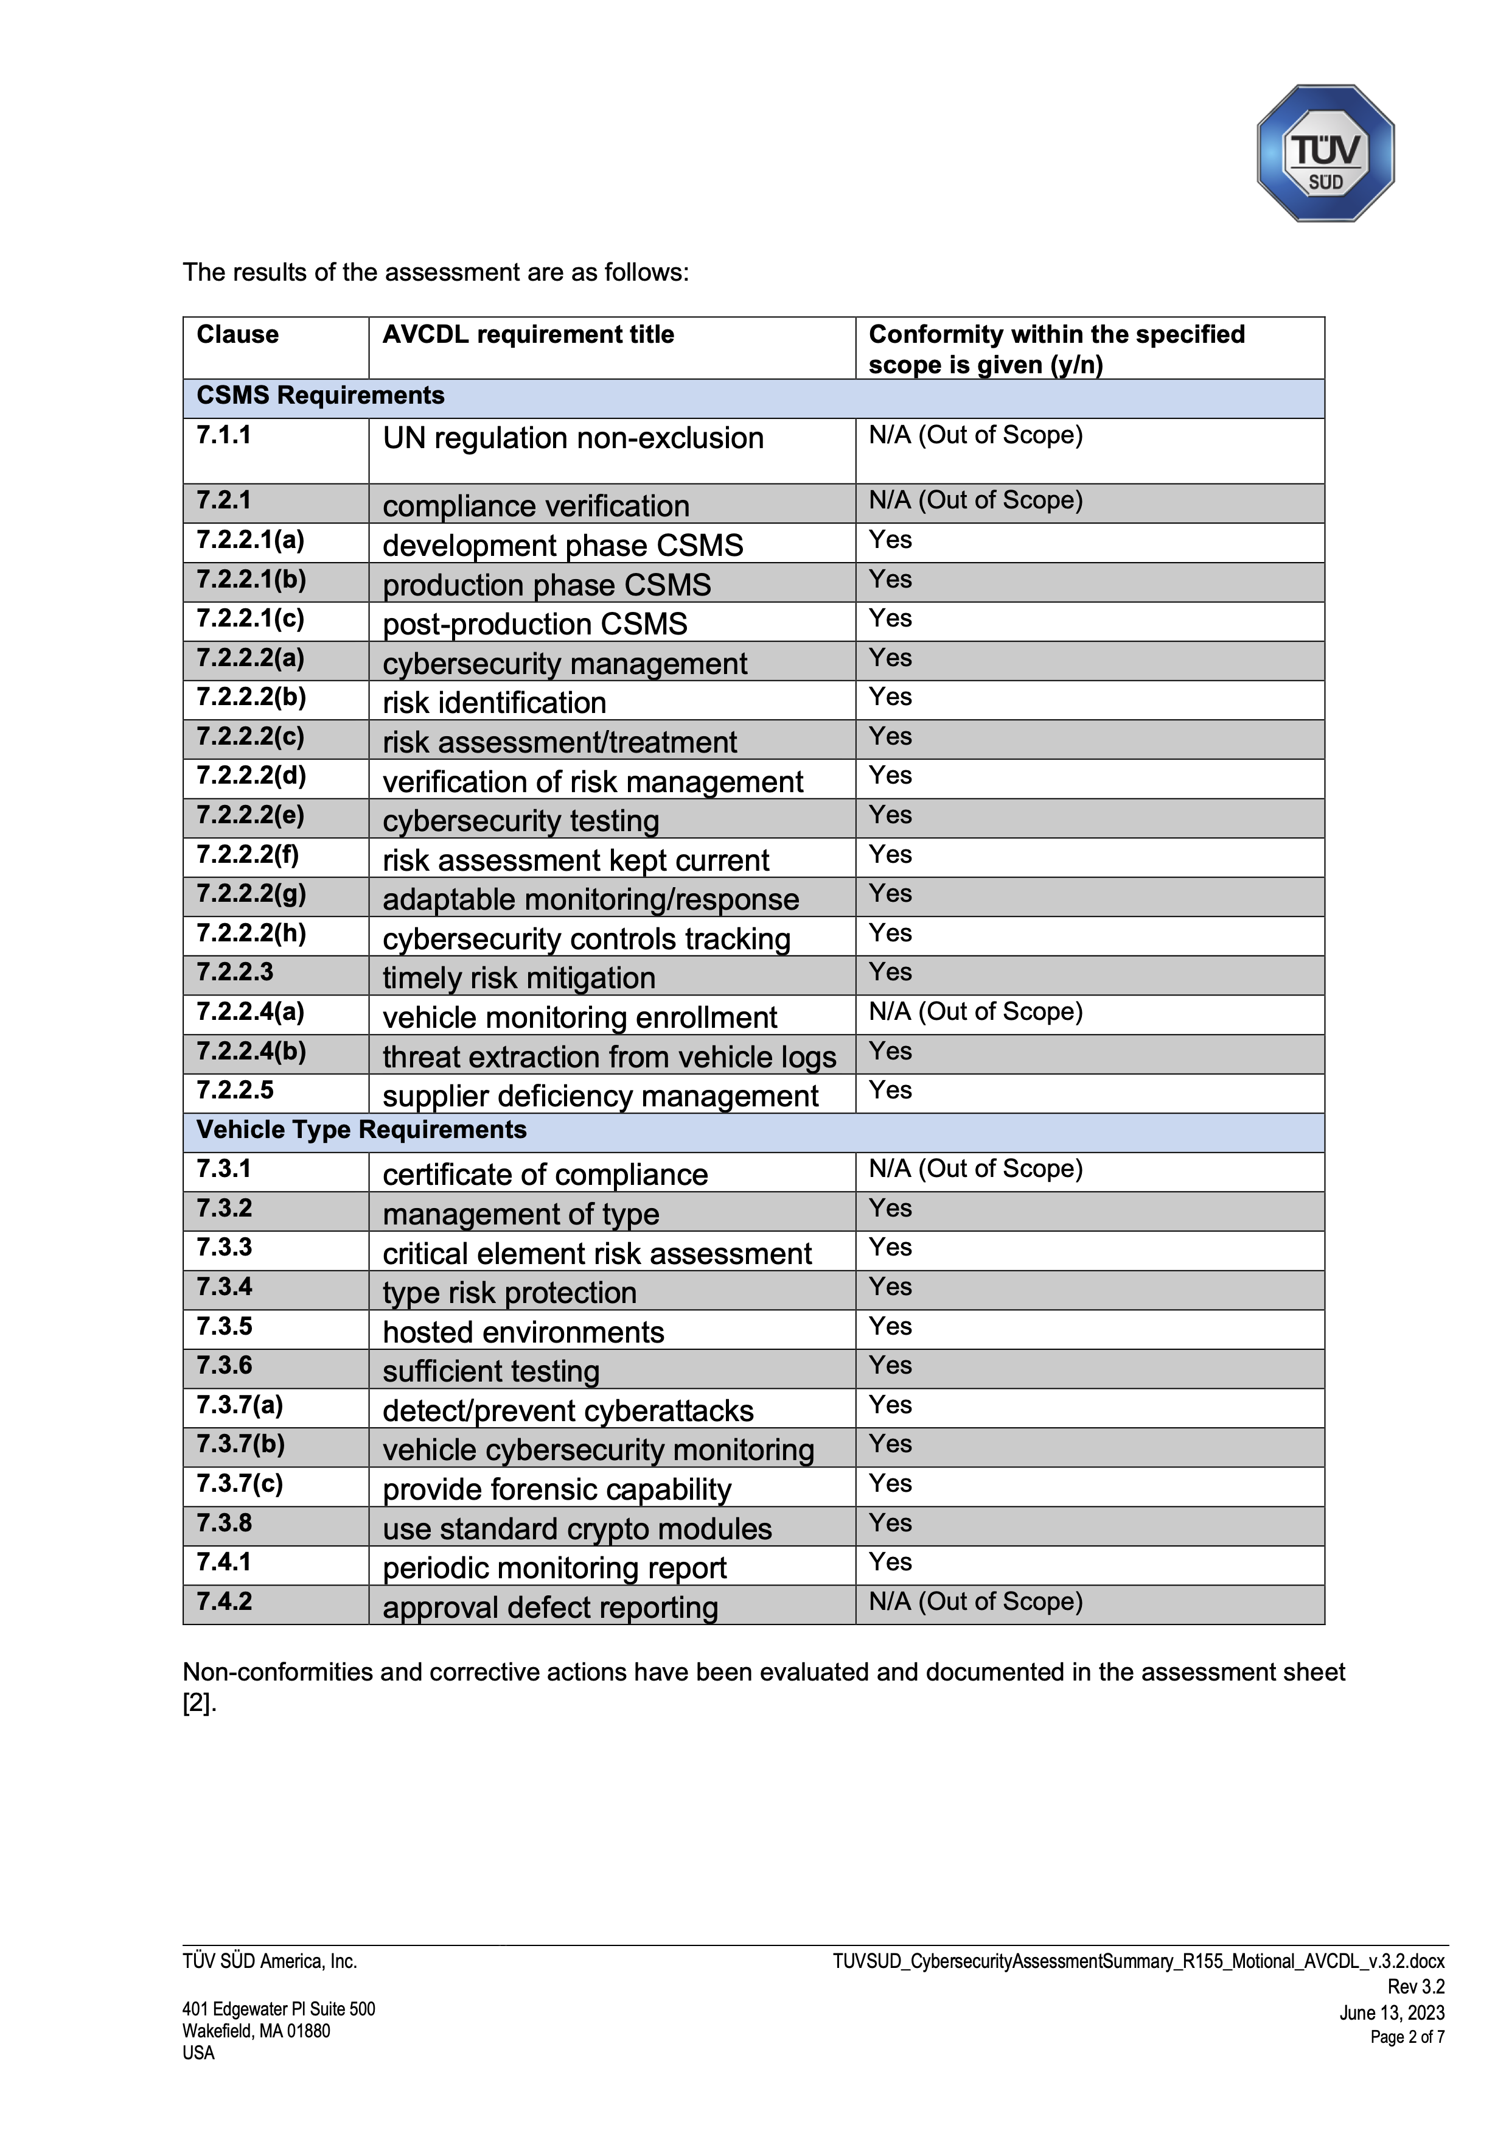
Assessed for Compliance
ISO/SAE 21434
UN R155
UN R155
Notes:
Script:
The AVCDL has been assessed for compliance with both ISO/SAE 21434 and UN R155.
This assessment was done by TÜV SÜD and you can see here the letters of assessment which are included in the AVCDL document set.
This was a line-by-line assessment of the AVCDL to ensure that if used that all the requirements of both 21434 and R155 would be met.
Having knowledge that the AVCDL satisfies both the standard and regulation, gives any organization a leg up when it comes product certification. Knowing that the path they're going to take has been validated greatly improves the likelihood of success.

Slide 24
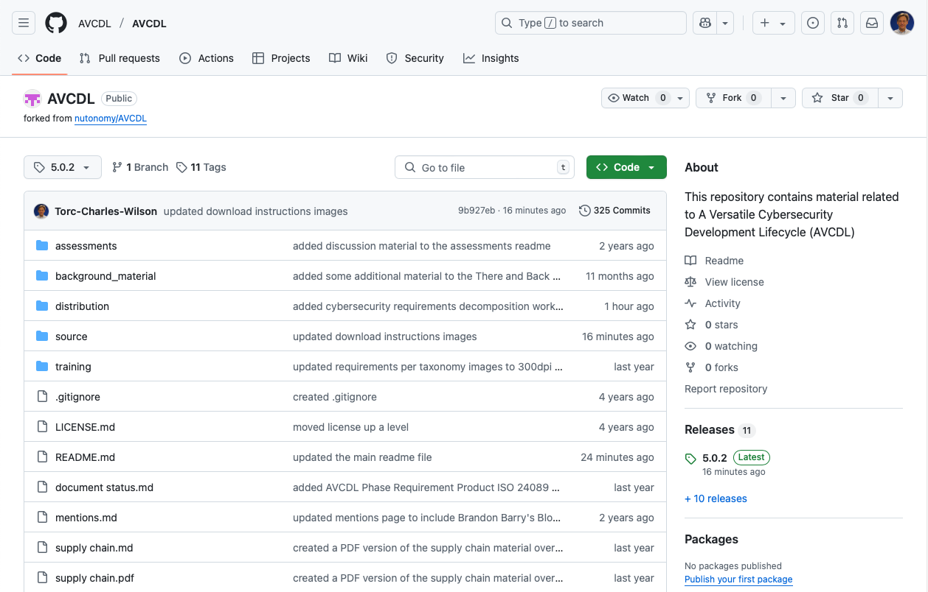
AVCDL on GitHub
https://github.com/AVCDL/AVCDL
Notes:
Script:
All AVCDL materials, both in source and distribution forms, are available on our GitHub site, as shown here.
Because of the size of the repository, it's recommended that you either clone the repository or download a ZIP archive of it, if you're not familiar with using git.
Instructions for downloading a ZIP archive are linked to on the repository’s front page.

Slide 25
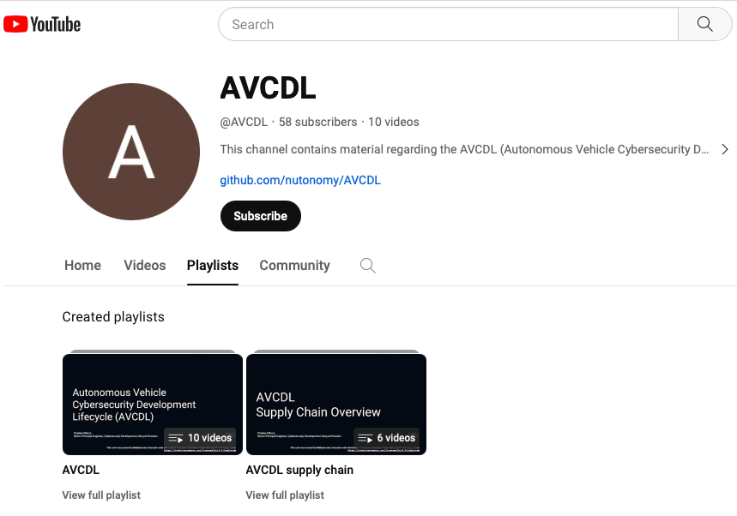
AVCDL on YouTube
https://youtube.com/@AVCDL/playlists
Notes:
Script:
A set of training videos have been created to cover various aspects of the AVCDL that follow the training path found in the AVCDL primary document.
It's important to note that all of the AVCDL materials with the exception of the introductory blog posts are intended for product cybersecurity engineering practitioners.

Slide 26
References (1 of 2)
Systems and software engineering - Software lifecycle processes
https://en.wikipedia.org/wiki/ISO/IEC_12207
Systems and software engineering - System lifecycle processes
https://en.wikipedia.org/wiki/ISO/IEC_15288
Road vehicles – Functional safety
https://en.wikipedia.org/wiki/ISO_26262
Secure Software Development for Autonomous Vehicles
https://www.sae.org/standards/content/iso/sae21434/
Microsoft Security Development Lifecycle (SDL) - simplified implementation
https://www.microsoft.com/en-us/download/details.aspx?id=12379
NHTSA Cybersecurity Best Practices for the Safety of Modern Vehicles
https://www.nhtsa.gov/sites/nhtsa.gov/files/2022-09/cybersecurity-best-practices-safety-modern-vehicles-2022-tag.pdf
NICE Cybersecurity Workforce Framework (NCWF)
https://nvlpubs.nist.gov/nistpubs/SpecialPublications/NIST.SP.800-181r1.pdf
Notes:
Script:
Finally, here are references used in the construction of this presentation.

Slide 27
References (2 of 2)
Secure Software Development Framework (SSDF) https://nvlpubs.nist.gov/nistpubs/CSWP/NIST.CSWP.04232020.pdf
How much do bugs cost to fix during each phase of the SDLC?
https://www.synopsys.com/blogs/software-security/cost-to-fix-bugs-during-each-sdlc-phase/
Path to Improve Product Quality, Reliability and Customer Satisfaction
https://ieeexplore.ieee.org/document/497665
AVCDL (GitHub)
https://github.com/AVCDL/AVCDL
AVCDL (YouTube)
https://youtube.com/@AVCDL
AVCDL Introductory Blog Posts
https://github.com/nutonomy/AVCDL/tree/main/background_material/blog_posts
UN Regulation No. 155 - Cyber security and cyber security management system
https://unece.org/transport/documents/2021/03/standards/un-regulation-no-155-cyber-security-and-cyber-security
Notes:
Script:
(carry over to fit time)

